Slide 1






“europe through the eyes of youth”
The youth of Aksakovo
20-22 April 2016, Setubal, Portugal

Slide 2
Statistics on Youth
18 % of population of Aksakovo Municipality are young people between 15 and 29 age;
6 % is unemployment, but
15 % is youth unemployment ;
20% are NEETs /neither in employment, nor in education or training/ young people;

Slide 3
Main priorities of local management in the field of youth
Projects for youth
Support school activities
Support culture and sport activities of youth clubs

Slide 4
Youth Enhancement Projects
Mayor´s Awards for Excellence
Municipal Internship Program
National Programme " Activation of inactive persons" in which Aksakovo was appointed junior specialist “youth mediator”
Project "Your future is in your hands “
Project “Hand by hand, looking to the world”
Involvement of young people in the campaign of BTV - Media Grup " Let's clean Bulgaria for one day"
Volunteering opportunities – chance to participate in all the activities related to the planning of sport and social . events

Slide 5
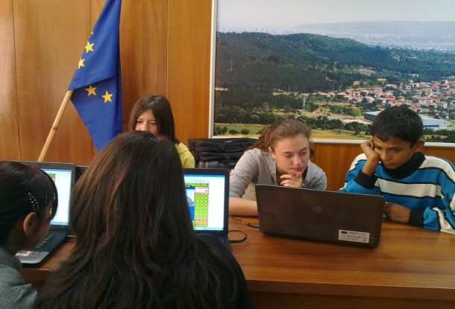
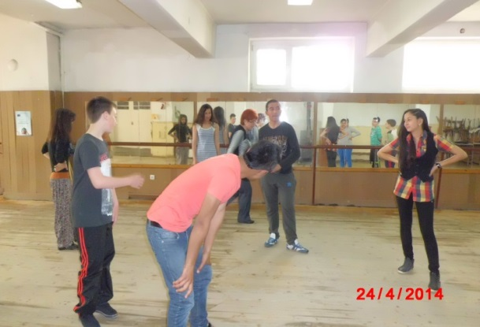
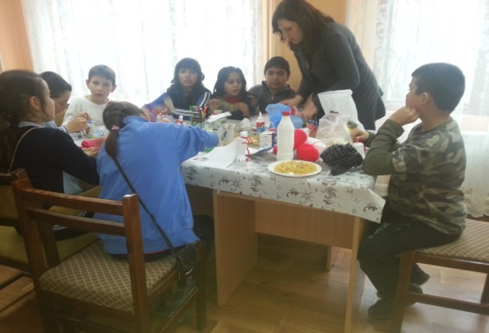
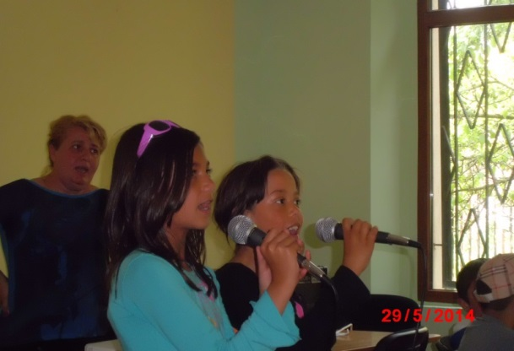
Project “Hand by hand, looking to the world”
Activities by interests

Slide 6
Support of school activities
4 primary schools, 2 secondary schools and Municipal children complex
Minicipality of Aksakovo support school activities often financially;
In the Municipal children complex takes part 250 children and young people in different out school activities as informal groups;

Slide 7
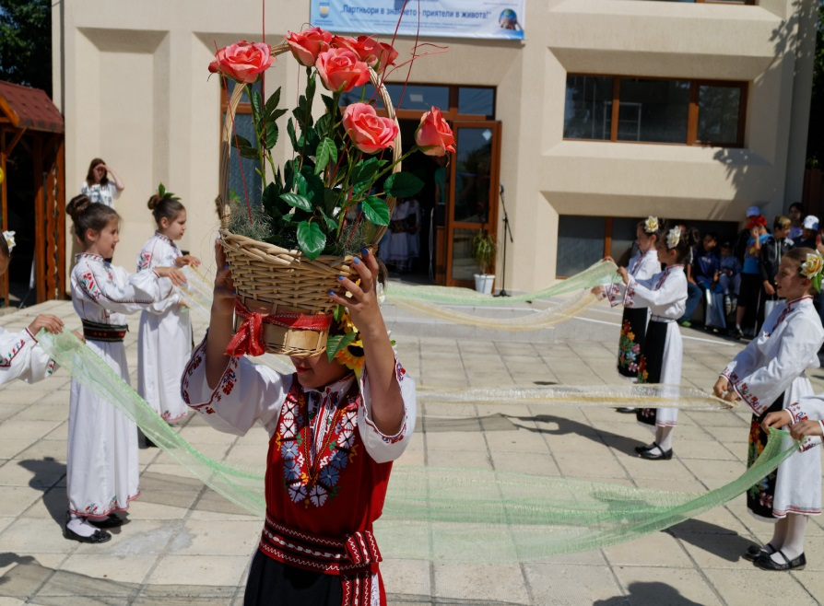
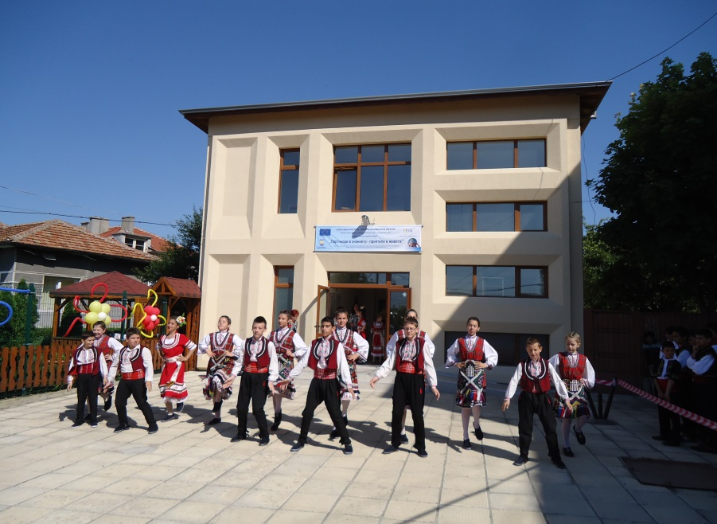
Support of school activities
Festival of ethnic tolerance

Slide 8

Preservation and enhancement of the Intangible Cultural Heritage
Focus on the wealth of knowledge and skills that are transmitted from one generation to the next;
The Municipality is committed to continuously increase the opportunities for young people and audiences to discover folk music and dances and raise the profile of folklore through high quality performance and learning experiences;
The local folk dance and song ensembles in conjunction with the support and encouragement of the Municipality perform at prestigious festivals;

Slide 9
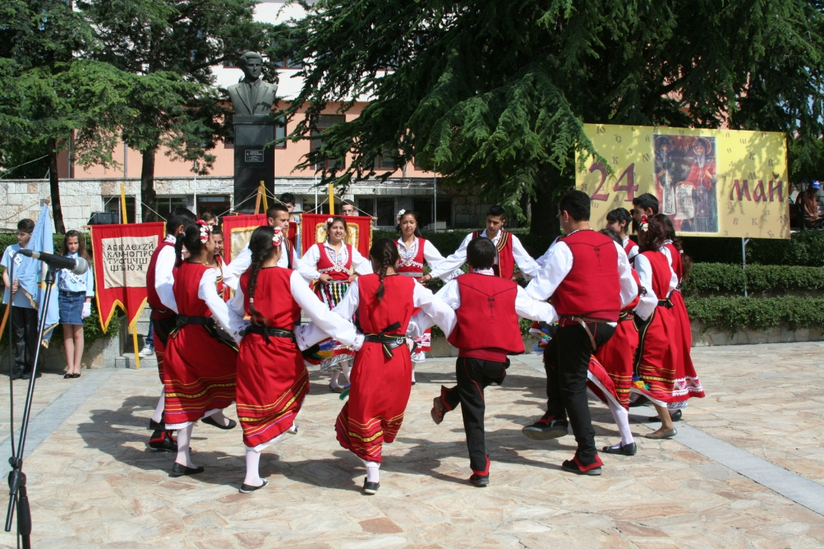
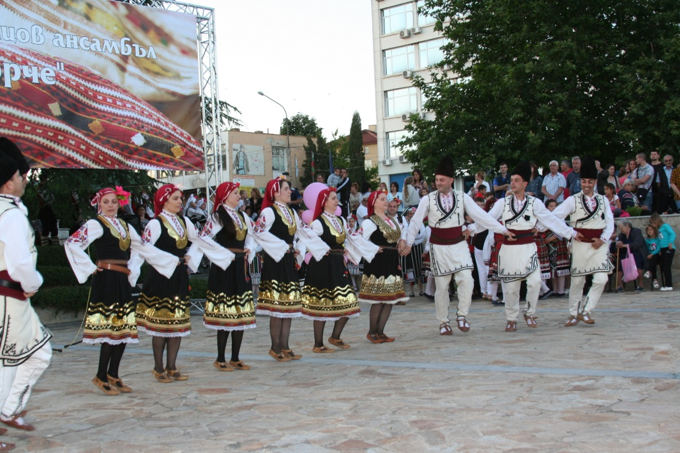
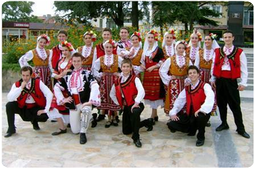
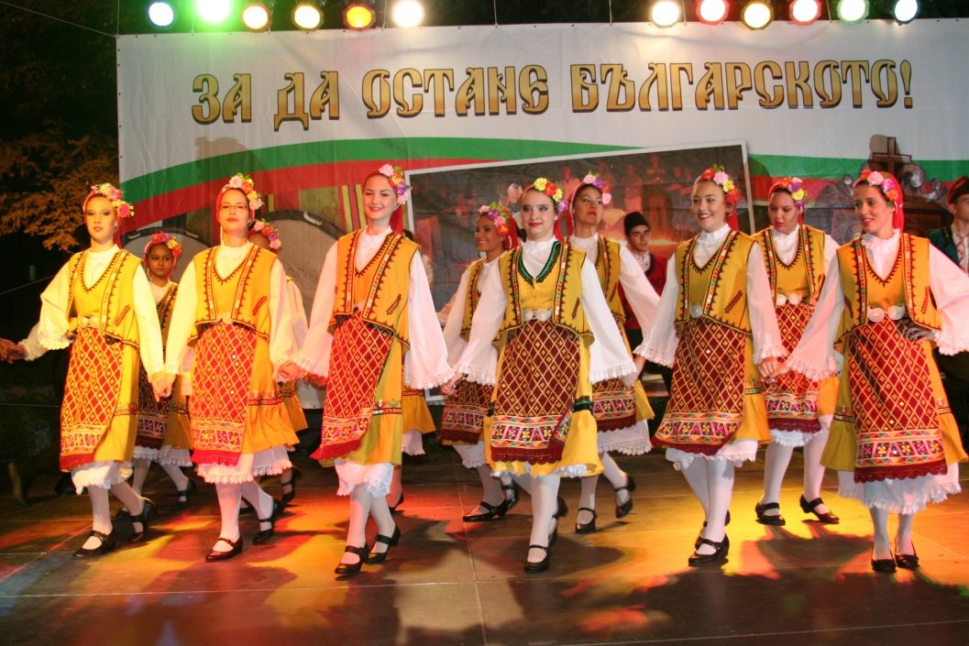
Active participation in the local activities, events and organizations

Slide 10

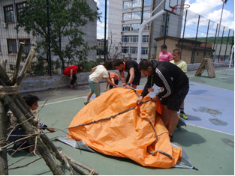
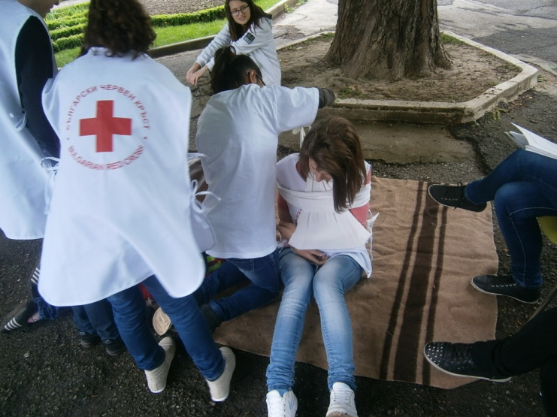
Promoting active youth citizenship
Scouting in Aksakovo- ‘’Vokil” is a branch of The Scout Association ‘’Vladislav Varnenchik’’- help in keeping the playgrounds and natural areas green and clear
First Aid Learning for young people- cooperation program between volunteers from the Bulgarian Red Cross and the Municipal Children Complex - Aksakovo

Slide 11
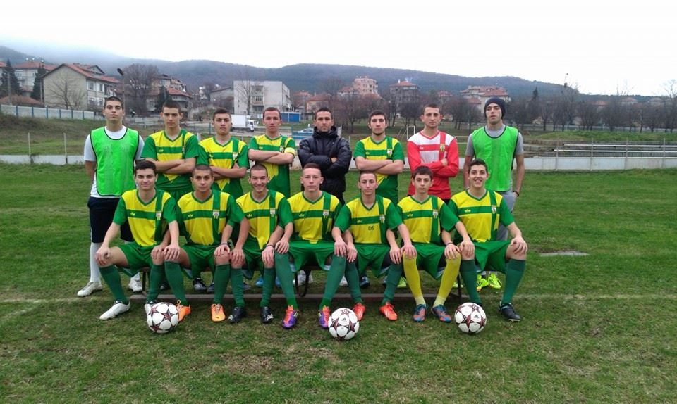
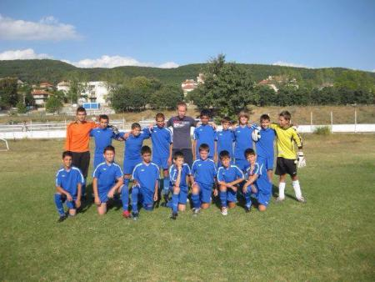
Sport Clubs at a glace
FC Aksakovo
FC Aksakovo 1948
FC Ignatievo

Slide 12
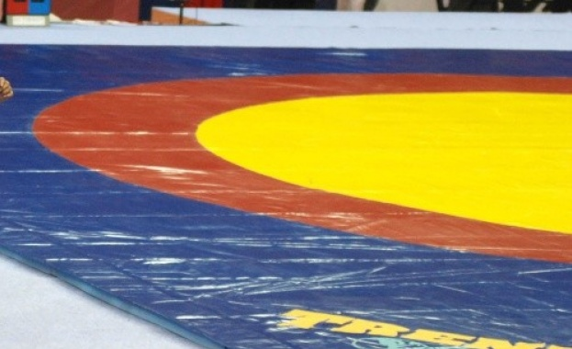
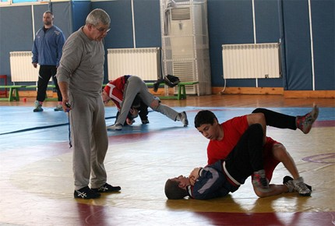
SC Primorec
Greco-Roman wrestling club
age categories: schoolboys and cadets

Slide 13
Municipal sports events
Futsal Tournament of the Aksakovo Municipality
Table Tennis Tournament
Belote Tournament
Bridge Tournament
Backgammon & Chess Tournament
Volleyball Tournament
Running Race

Slide 14
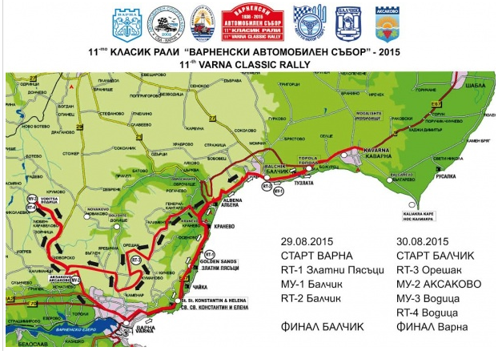
Aksakovo- part of the Varna Classic Rally

Slide 15
Thank you for your attention!

