Slide 1



Association BIO Network (Network for Life) is a non-profit association formed by three business companies. BIO NETWORK actively works for the creation of public attitudes and policies on healthy and natural way of life, family values ​​and protection of the environment, especially in areas with higher urban pressures.

Slide 2

Motto: The life is priceless!
- Provokes new initiatives with socially meaning in the area of body activities, healthy food and information accessibility;
- Works hard to change attitudes at all levels of public communication;
- Prepares projects related to different areas of local, government and international manage priorities;
- Promotes prevention of common diseases associated with harmful locomotion activities and eating habits;
- Supports people and organizations to reach balance and harmony with the nature on our planet;
- Organizes meetings, conferences, information days, presentations and festivals.
BioNet is an institutional organization opened for everyone who is ready to approve life as priceless gift.

Slide 3
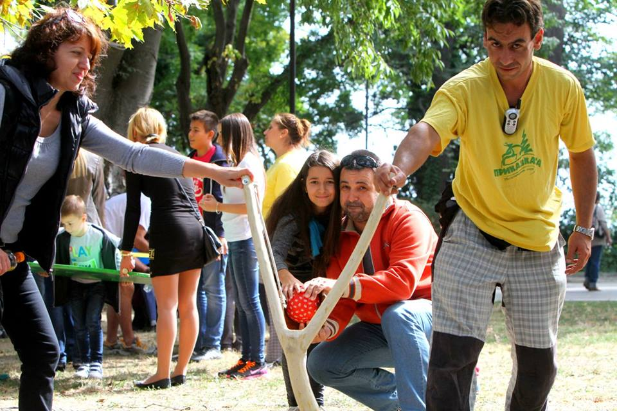
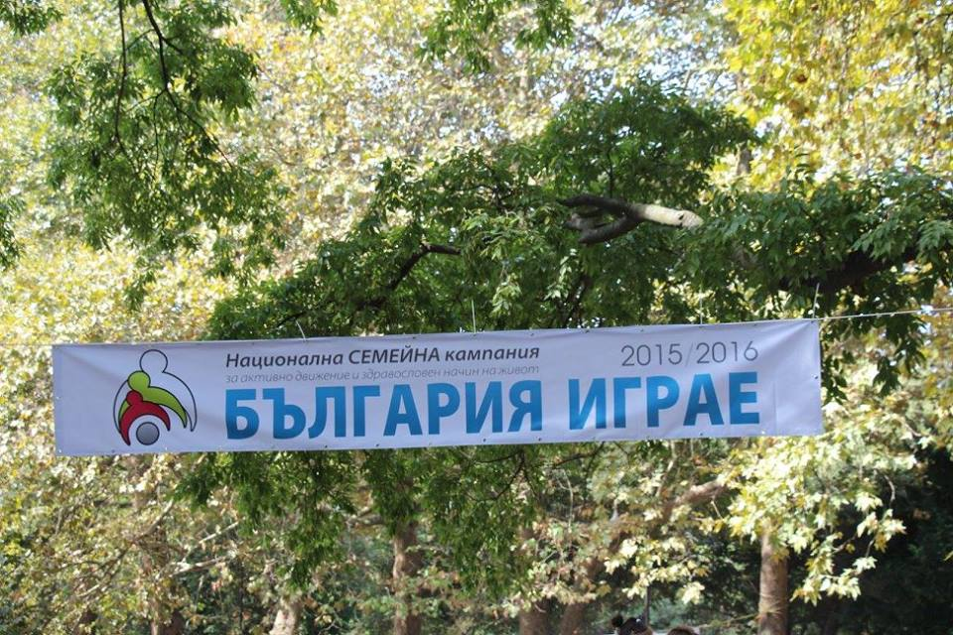
Own projects:
National family campaign for active and healthy life “Bulgaria plays”.
The aim of the campaign - to unite families and remind them to find free time to be together -typical Bulgarian retro games as piece of elastic, camp cars and etc.
The initiative was carried out in the Sea Garden in Varna – in 2015 and 2016. 600 people from 280 different families.

Slide 4
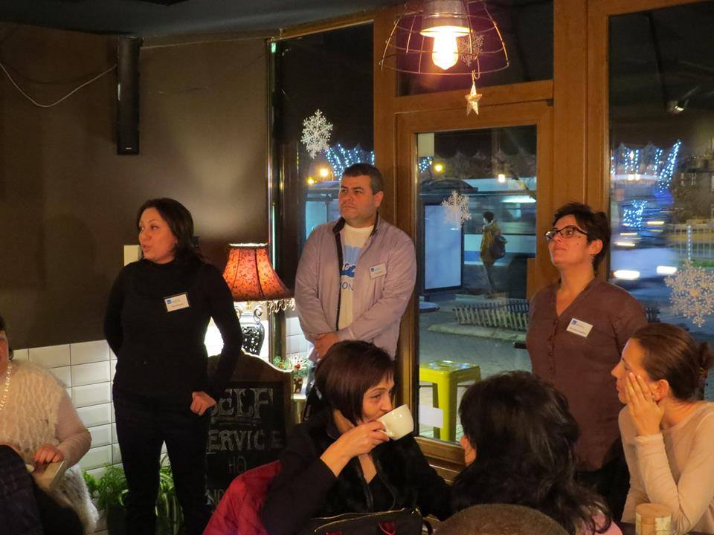
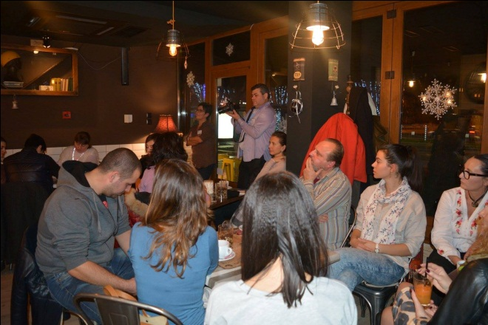
Project „The table of my family“ – in partnership with producers of healthy food and future young chefs, who are finishing the Tourism Vocational school in Varna. We organize funny and interesting presentations of healthy receips – we attract families to cook together during events for healthy life.

Slide 5
Projects for BioNet, financed by public instruments:
Culinary neighbourhood – project financed by Interreg – IPA CBC – Bulgaria –Turkey partnership
This project focuses on the development of tourism in the cross border area, based on intangible cultural heritage and especially local cuisines on both sides of the border which share many common features.
The project will create conditions to develop common transnational culinary routes in the cross-border region for multiday tours, enabling tourists from both sides to learn about each other, share recipes and experiences related to culinary traditions and thus - to connect and draw together the two border regions.

Slide 6
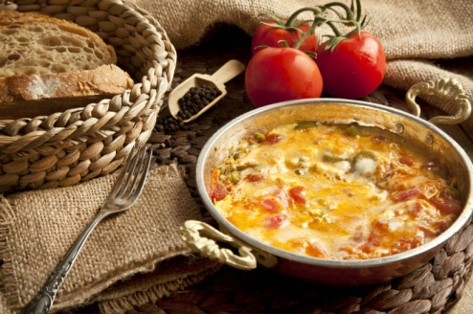
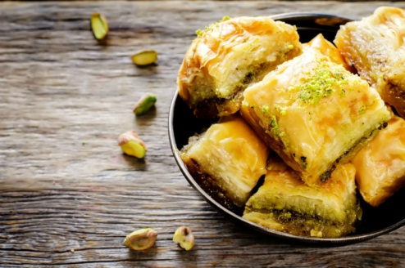
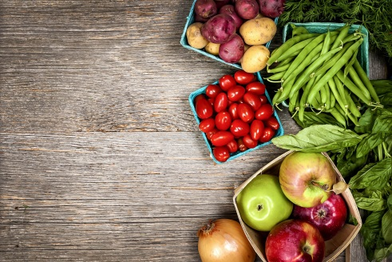
- Training for the restaurant owners and tourist agencies:
• opportunities for village tourism;
• culinary tourism – potential;
• recipes which can be offered in the restaurant in and around Edirne and Bourgas;
- Culinary festivals in Bulgaria and Turkey;
- Movie – presenting parts of the festivals, expert comments;
- A Culinary book with Bulgarian and Turkish recipes „What do you put in it dzhanym?“

Slide 7
Plant Kapana
Plovdiv is the European Capital of culture 2019. Our project for Kapana is partly financed by Association Plovdiv 2019.
Aim – to show how fast and easy everybody can become an artist while taking care of his own health and growing food on his own.
Developing garden skills in urban environment which helps for its aesthetic vision.
Public demonstration of different ways for growing plants on the balconies, roofs and outer walls.

Slide 8
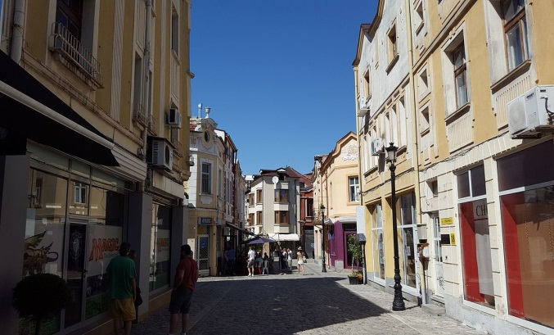
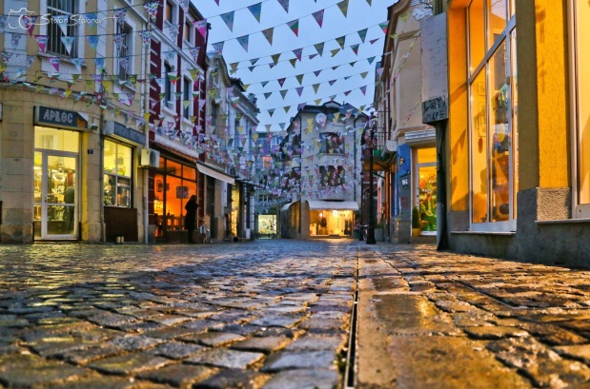
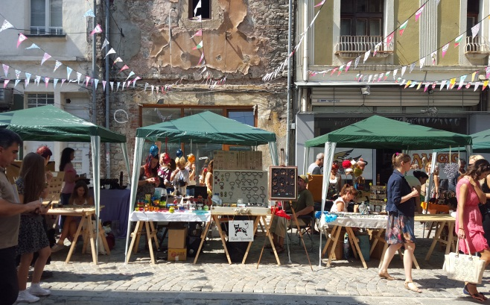
Expected results:
5 created urban gardens;
20 received projects for urban gardens from people of the neighbourhood;
Created conditions for further realising projects for urban gardening in citizen`s homes and whole spaces in Kapana.
200 citizens and residents included as spectators and followers of the idea;
Developing of a new art industry in Kapana;

Slide 9
What do we plan?
New initiatives related to health and body activity.
We would like “Bulgaria plays” to have issues in other cities every year.
We would like to work with children and youths for creating skills of healthy eating.
We are working on a project to work with families and to teach them not to throw out food – to plan how much food to buy, what food, how to keep it fresh, how to cook it right and recycle after it.
We start initiatives for preventing children`s spine curvature disorder.
We would like to work on a project for bicycle tours in Black sea area – we want to be financed by Black Sea partnership programme.
We would like to create a Bio nest – social enterprise, where women over 50 years, unemployed, will work temporarily until they find a job.

