Slide 1
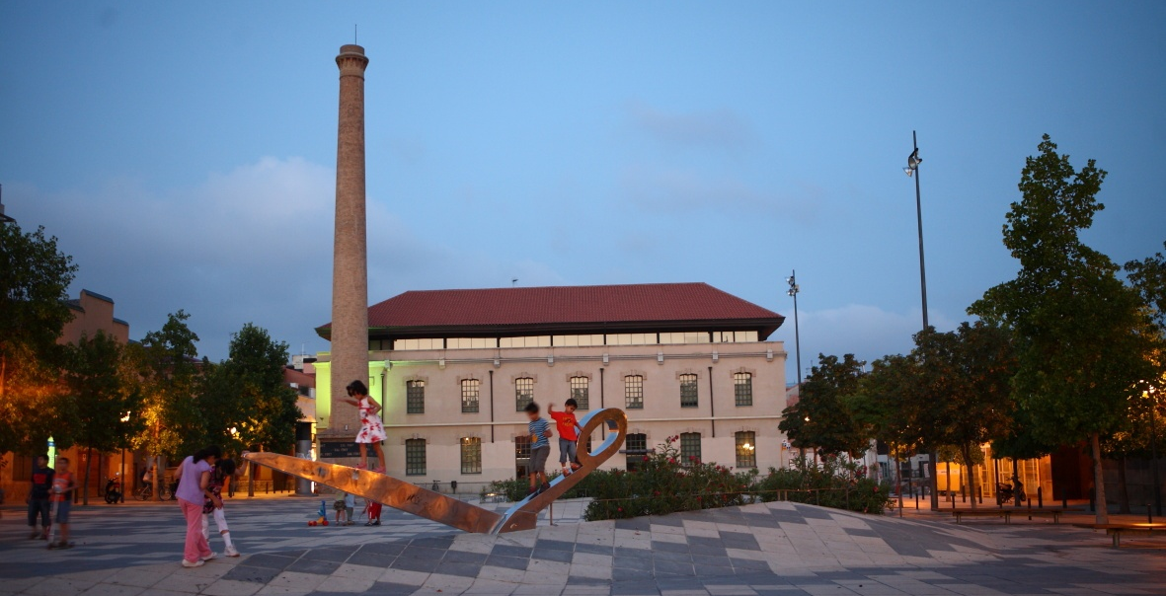
IGUALADA

Slide 2
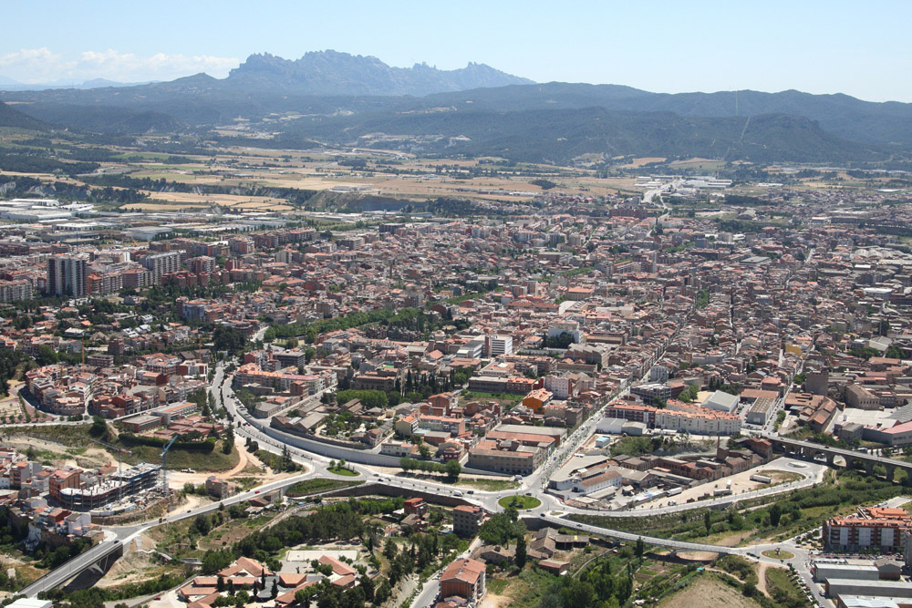
Where?
In Catalonia (Spain)
60 km from Barcelona
8 km²
39,000 inhabitats

Slide 3
Key economic sectors
Traditionally, Igualada’s economy has been based on the industrial sector, mostly the leather and textile industry.
As the industry has suffered a significant decline in the last years, Igualada is now promoting other sectors such as the ICT, Health and several events to attract visitors to the city.

Slide 4
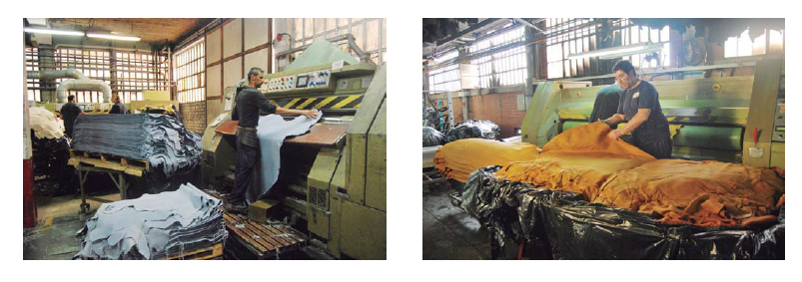
Igualada, European Capital of Quality Leather
Igualada’s tanning and leather processing industry has over 700 years of tradition.
30 companies, 1,200 jobs and a turnover of 170 million € per year.
They export 80% of its production to the main international brands of luxury sector (Dior, Prada,etc).
University Studies + Chair A3 in Leather Innovation

Slide 5
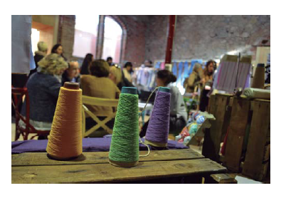
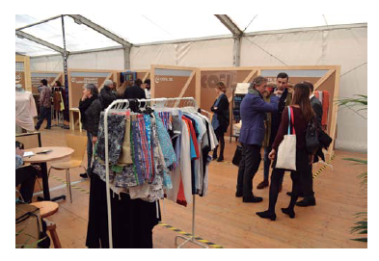
Textile – Knitting fashion
140 knitting companies, 2,900 jobs and a turnover of 340 million € per year.
Decline over the past few years due to liberalization processes and the relocation of companies to lower-wage countries.
Igualada is now promoting the textile reindustrialization process. As a result, some productions are returning to Igualada.

Slide 6
ICT
80 companies
Existing professional training offer
ICT companies in Igualada are demanding more jobs than the existing ones >>> there is a need to train more professionals in this area.
The City Council has requested a University degree in this field.

Slide 7
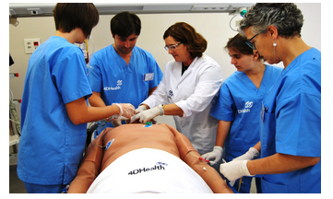
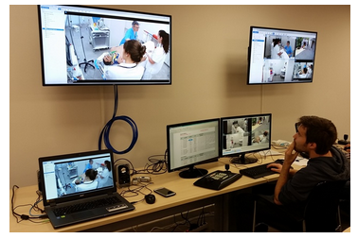
Health
New studies in Nursery
4D Health Innovation Simulation Centre: a pioneering simulated centre in Spain and Southern Europe that recrates the whole health environment. It is a simulated hospital to reduce the health errors by training professionals using simulation.

Slide 8
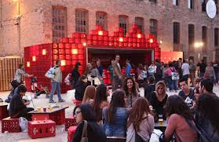
Events
Different leisure and cultural activities take place in Igualada along the year. They are great opportunities to promote the economic activity.
European Balloon Festival
Urban Running Night Show
Rec.0
Fairs: Aerosport, FirAnoia
Children’s Theatre Festival
FineArt exhibition

Slide 9
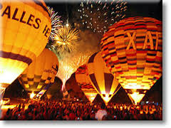

European Balloon Festival
Largest balloon concentration in Catalonia and one of the largest in Europe.
More than 50 hot air balloons coming all around the world and more than 25.000 visitors

Slide 10
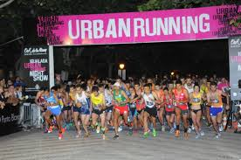
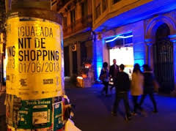
Urban Running Night Show
Night race through the streets of Igualada.
The race is complemented with other activities to attract visitors to Igualada such the Shopping Night and concerts.

Slide 11
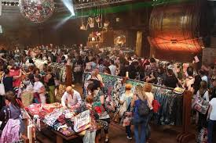
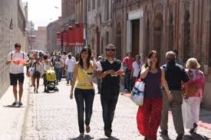
REC.0 Experimental Stores
Retail event that over 4 days twice a year, tanneries are transformed into pop-up stores where international brands, local brands and designers offer their products with special offers. Complemented with culture, music and gastronomy offer.
More than 117,000 visitors and a turnover of 7.5 M € in 2014.

Slide 12
TWINNINGS CITIES
Igualada enjoys two types of twinning :
Twinning of Cooperation (North-South) with a focus on solidarity among municipalities of industrialized countries and Third World countries. Igualada is twinned with:
  Nueva Esperanza (El Salvador)
  Mahbes, Sahrawi refugee camp (Tindouf)
  Trávnik (Bòsnia)
Europeans twinning, between EU cities and in the context of the integration process.

Slide 13
EUROPEANS TWINNINGS
3 European twinned cities:
Lecco (Italy)
Aksakovo (Bulgary)
Guimaraes (Portugal)
Twinning aims at encouraging the cooperation, cultural and economic relations among cities.

Slide 14
GOALS
The goals are:
  Defending the importance of the relations between cities.
  Make known our culture.
  Keep exchanges.
  Utilize new technologies to improve and deepen relations between the citizens of Europe.
  Strengthening relations with twin cities.

Slide 15
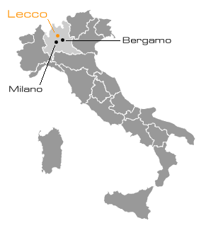
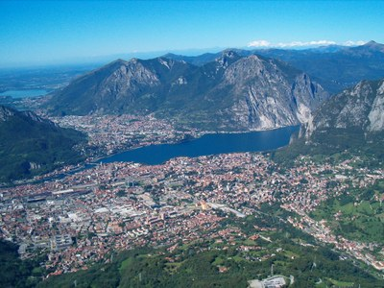
Lecco - Italy
Municipality of the region of Lombardy, north of Italy, on the shores of Lake Como.
48,000 inhabitants
Twinned with Igualada since September 23, 1990.
www.comune.lecco.it

Slide 16
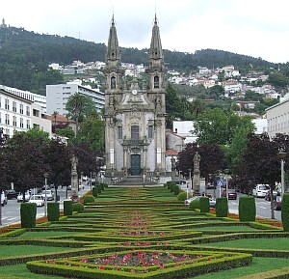
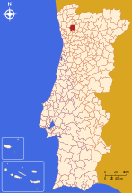
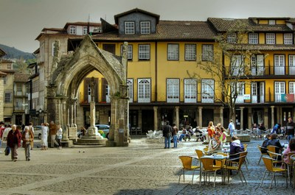
Guimaraes - Portugal
Located in the North of Portugal, in the district of Braga, in the historical and cultural province of Minho.
162,000 inhabitants
Twinned with Igualada since June 24, 1995.
www.cm-guimaraes.pt

Slide 17
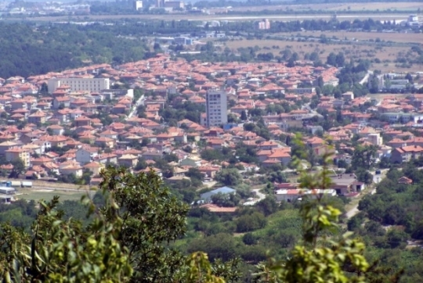
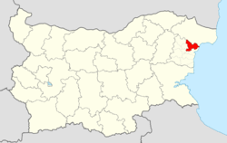
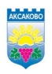
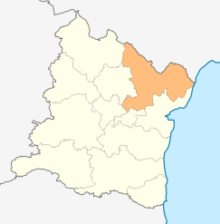
Aksakovo - Bulgary
Located in the North East of Bulgary, in Varna Province
20,000 inhabitants
Twinned with Igualada since 26 de Septiembre de 2009.
www.aksakovo.info.bg

Slide 18
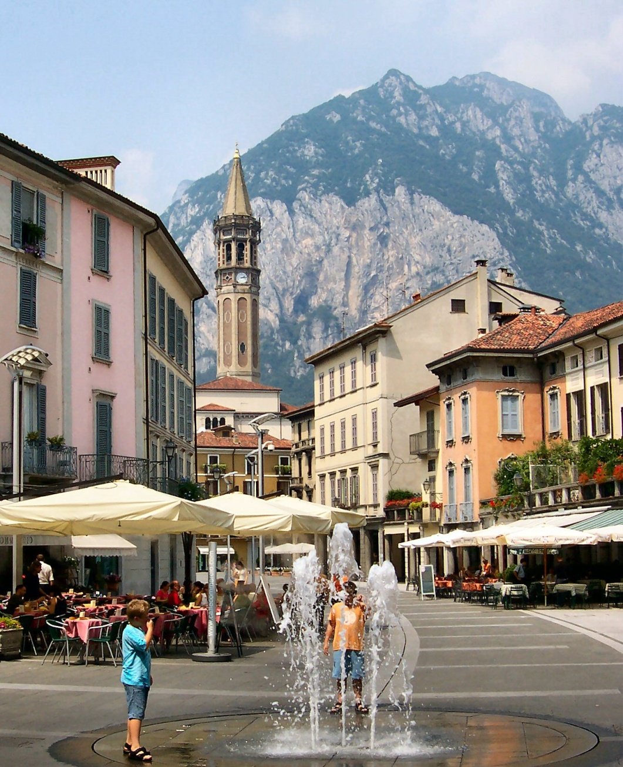
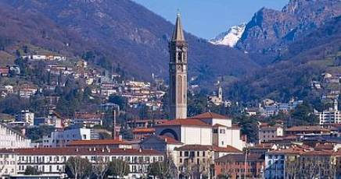
Activities of twinned towns
Aksakovo – Guimaraes – Lecco
Meetings of various cultural entities twin cities:
  Dance.
  Folk Acts.
  Exposition, etc…
Lecco
Lecco

Slide 19
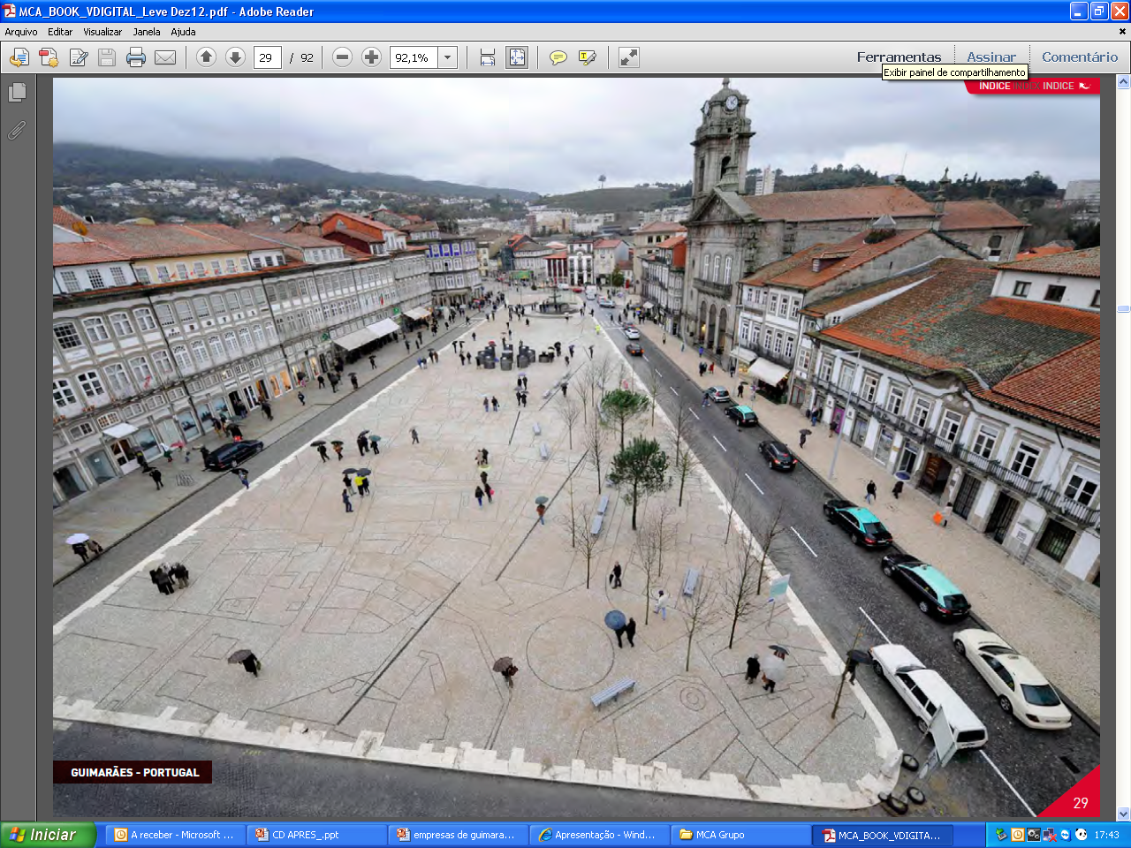
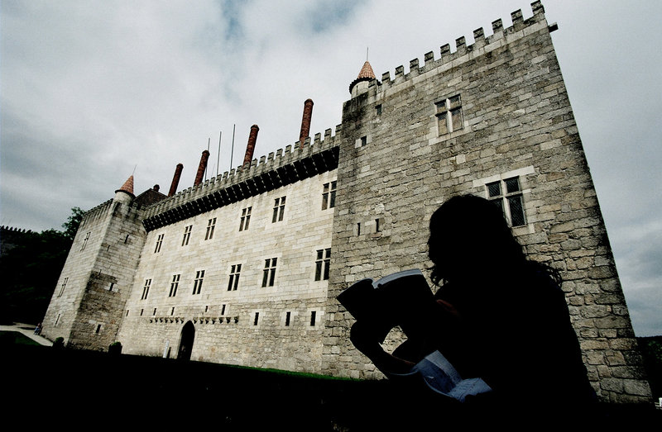
Activities of twinned towns
Aksakovo – Guimaraes – Lecco
Meetings between industry organizations for potential trade and business exchanges:
  Union of Entrepreneurs.
  Chamber of Commerce.
  Important local companies in different sectors.
Guimaraes

Slide 20
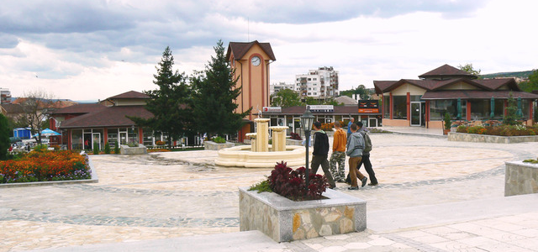
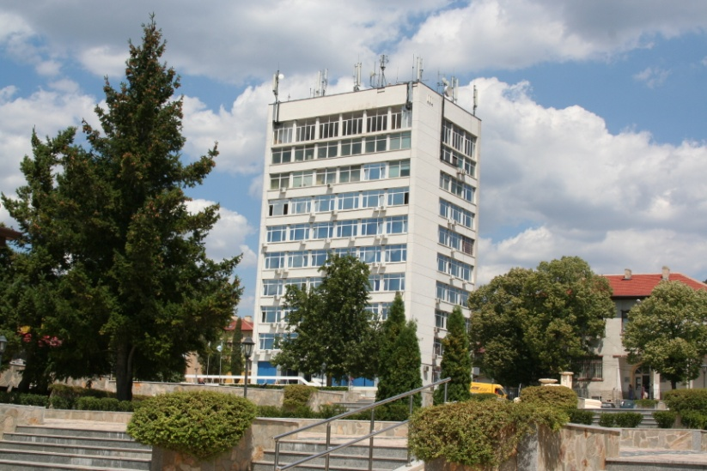
Activities of twinned towns
Aksakovo – Guimaraes – Lecco
Lectures on various aspects of public services and possible solutions :
  Selective waste collection.
  Sewage and water treatment.
  Commercial network between cities.
Aksakovo
Aksakovo
Notes:
Encuentros de entidades culturales de ambas ciudades :
Espectáculos de danza, folclóricos, exposiciones, etc…
Reuniones de trabajo entre organizaciones del sector económico para posibles intercambios comerciales y empresariales: Unión de Empresarios, Camera de Comercio, empresas importantes locales de diferentes sectores.
Conferencias sobre diferentes aspectos de servicios públicos y sus posibles soluciones:
Recogida selectiva de residuos
Depuradoras y tratamientos de aguas
Red comercial entre ciudades

Slide 21
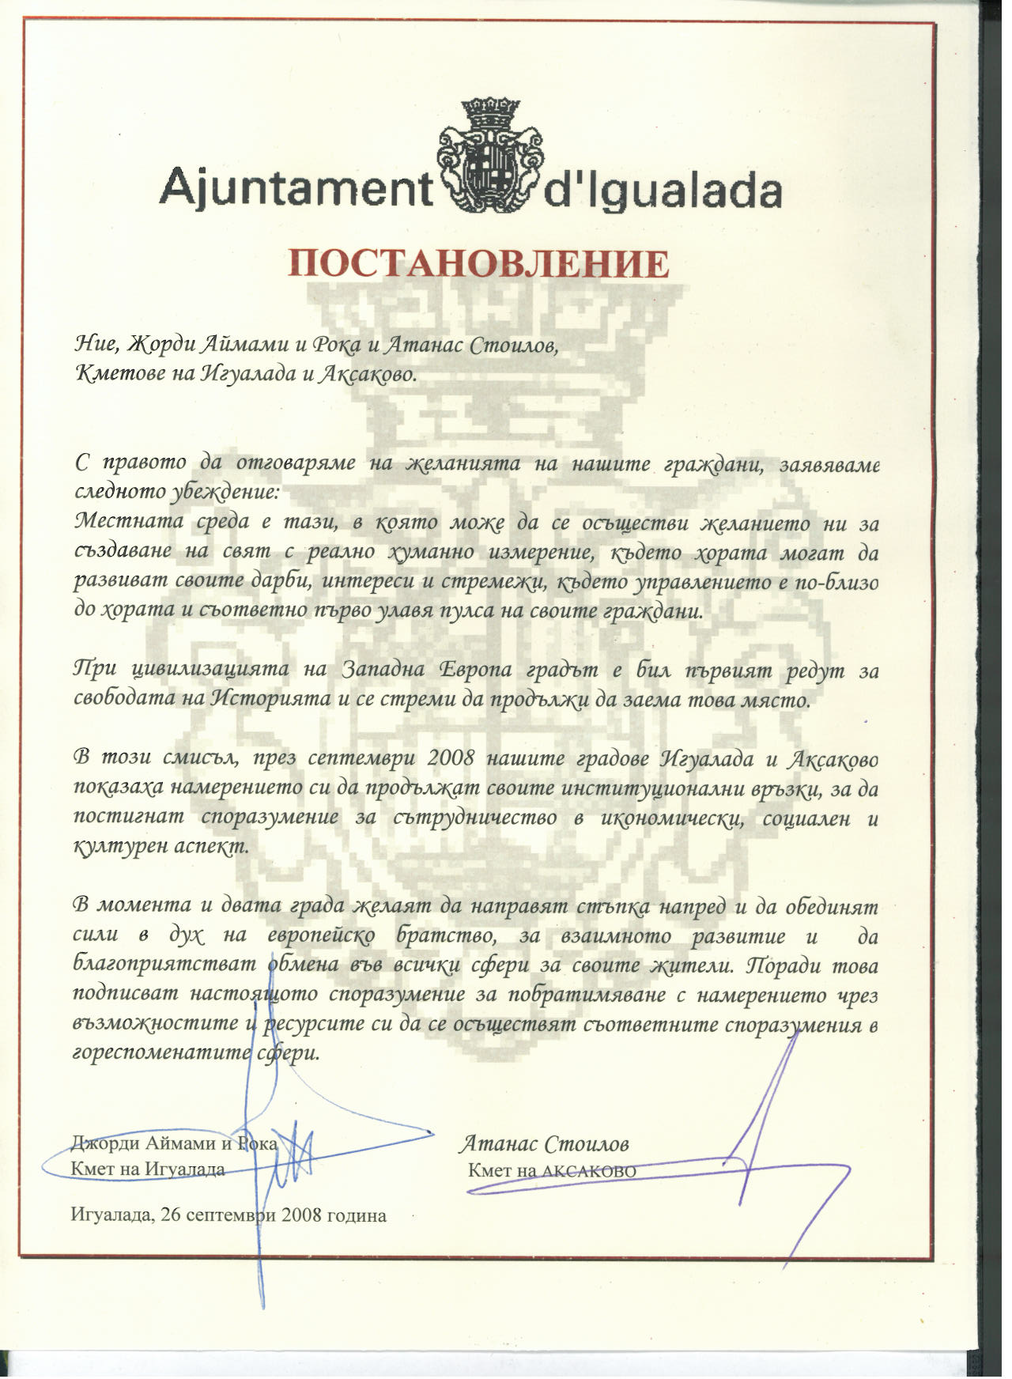
Lecco - Italy
Main activities between Lecco and Igualada:

Slide 22
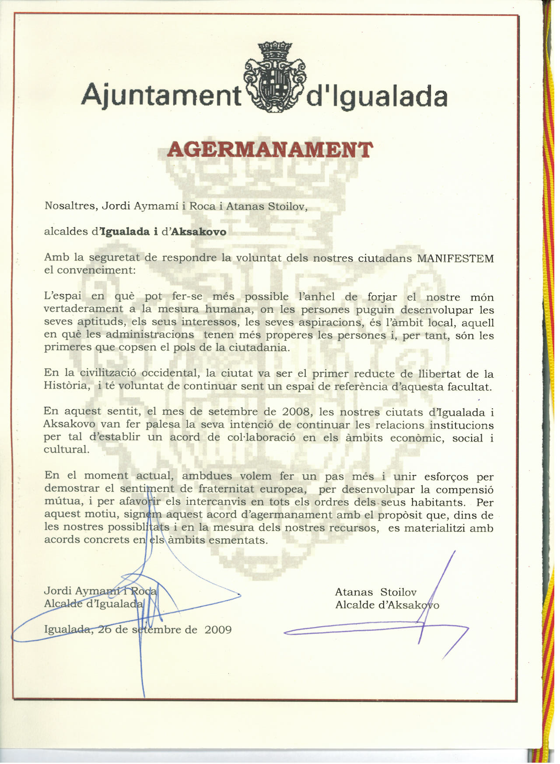

Slide 23
CONCLUSIONS
Twinnings are a good method to begin the internationalization of the municipalities.
They are ideal for knowledge management of cities.
Networks are tools that enable connection and relationship to achieve goals and create opportunities.
Twinnings and networks are important for building the “European Citizenship”, to generate future European projects and seek business opportunities through business contacts.

