Slide 1
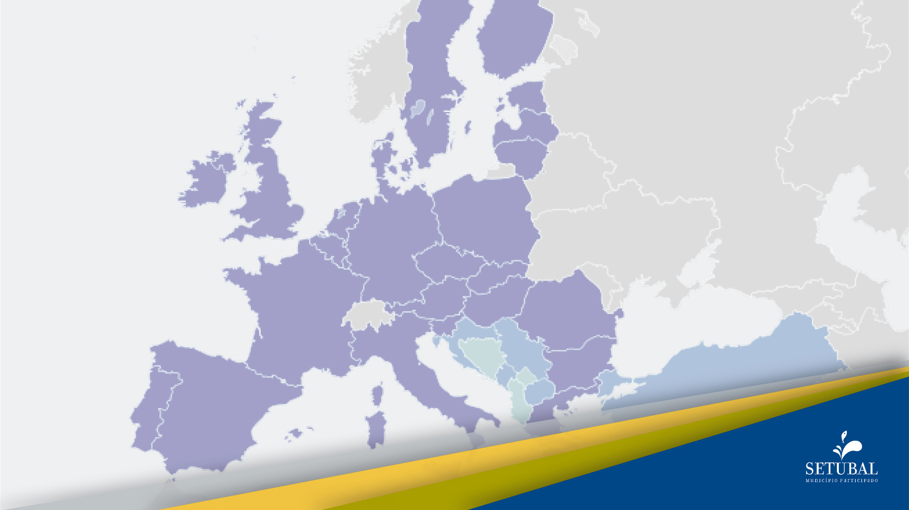
Economic and social problems arising from the accession of Portugal to the EU
DISADVANTAGES

Slide 2

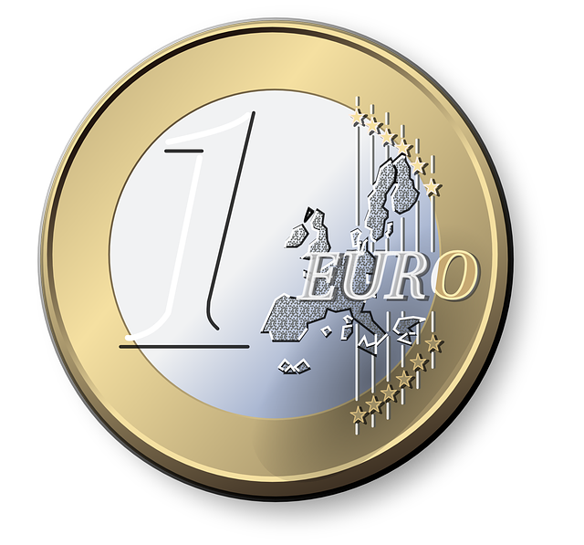
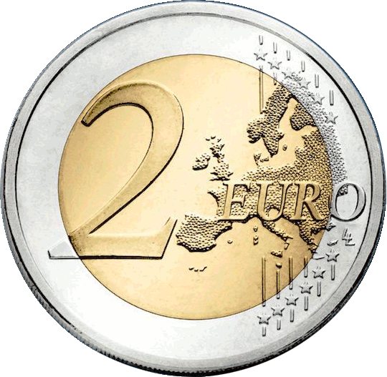
Economic and social problems arising from the accession of Portugal to the EU
DISADVANTAGES
Disposal of monetary sovereignty to join the euro in the Maastricht Treaty

Slide 3
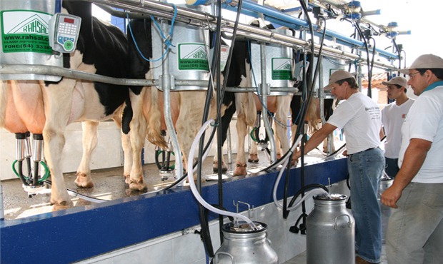
Economic and social problems arising from the accession of Portugal to the EU
DISADVANTAGES
Transfer of the management of the living resources in our Exclusive Economic Zone to the EU

Slide 4
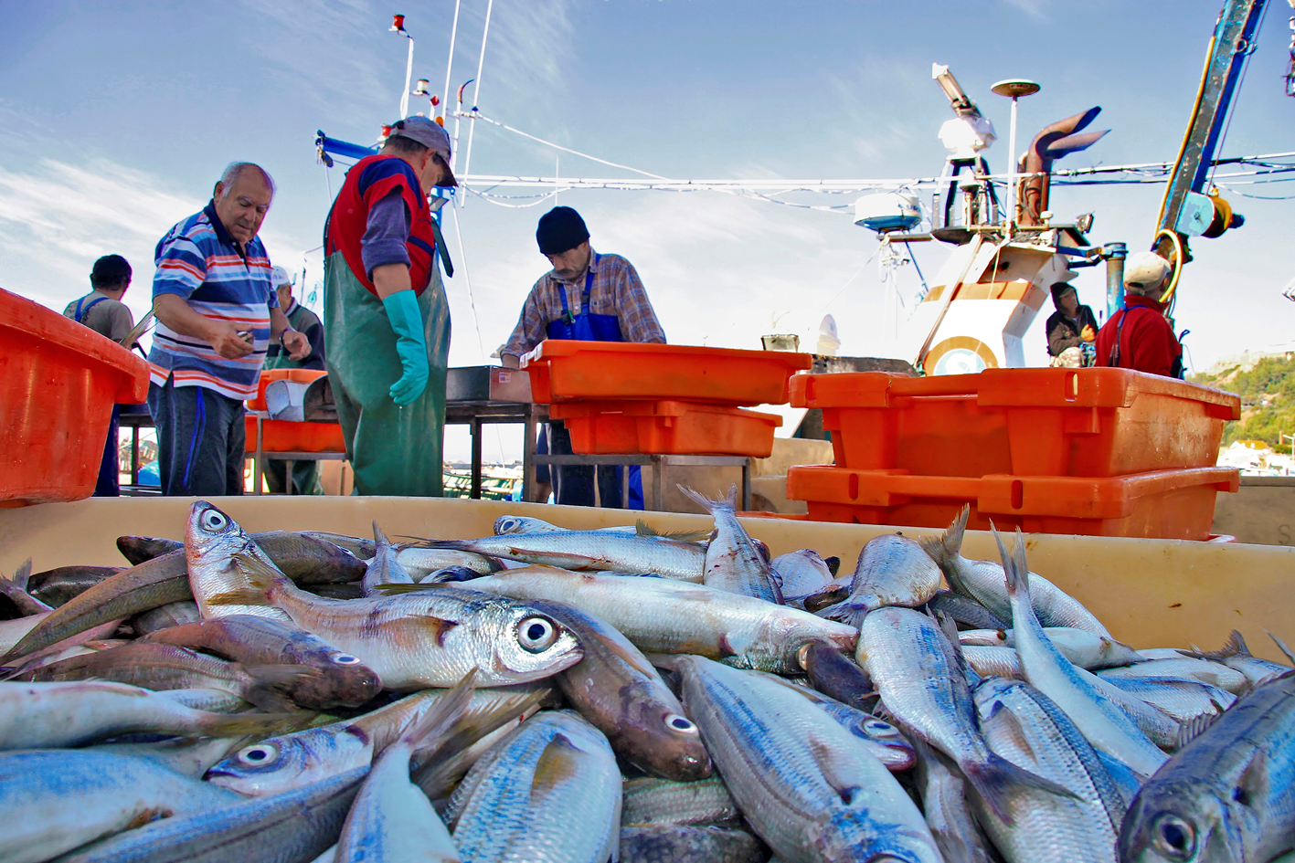
Economic and social problems arising from the accession of Portugal to the EU
DISADVANTAGES
Decommissioning of the fishing fleet in exchange for subsidies

Slide 5

Economic and social problems arising from the accession of Portugal to the EU
DISADVANTAGES
Privatization of strategic companies dictated either by government policies, either by imposition of the EU - electricity (production and distribution), post offices, airports, aviation

Slide 6
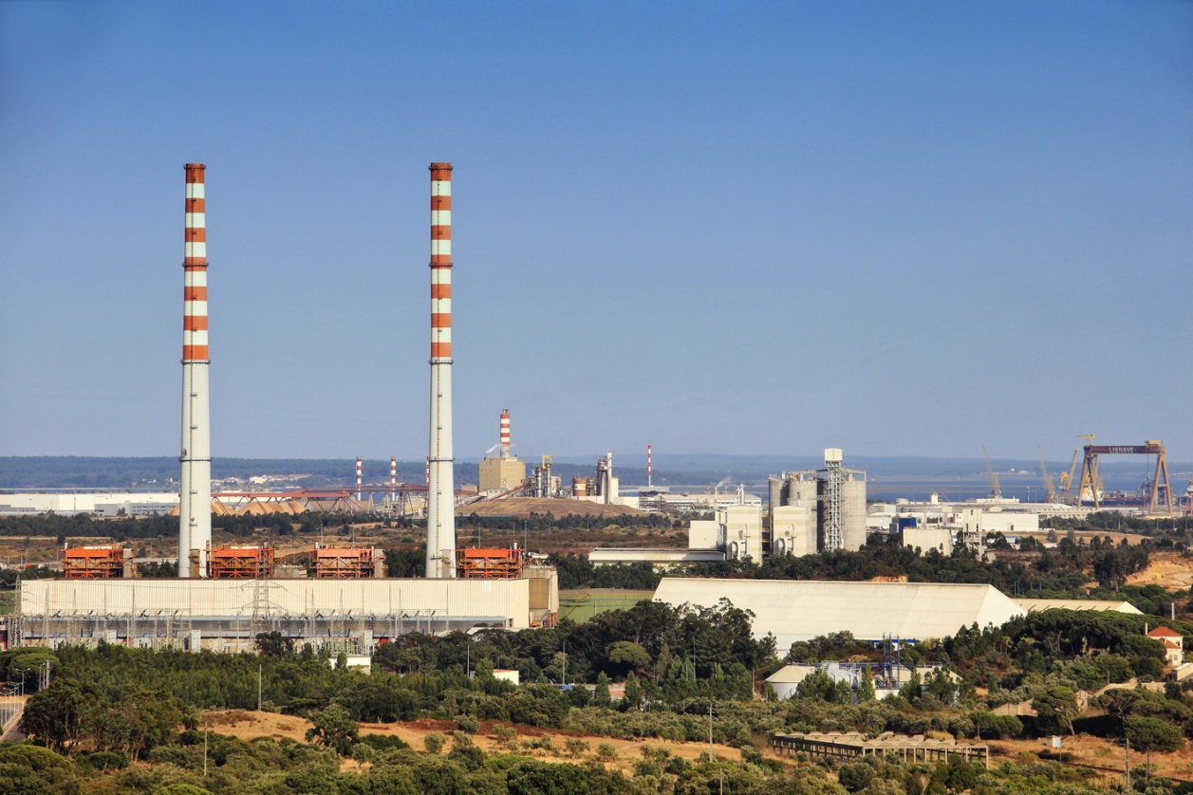
Economic and social problems arising from the accession of Portugal to the EU
DISADVANTAGES
Deindustrialization of the country and overdevelopment of the financial sector. The industry declined by 8.1 percent in cumulative terms over the past four years. EU policies and international financial crises have led us to a deep crisis the consequences of which we strongly experience today

Slide 7
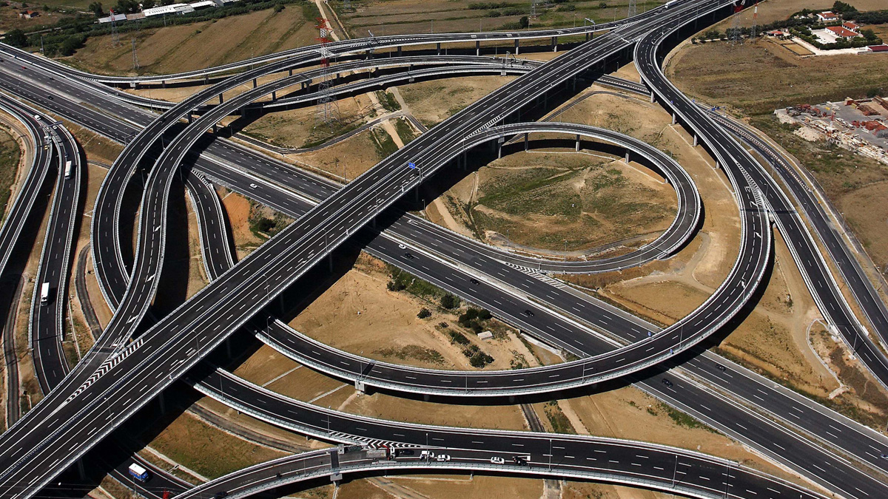
Economic and social problems arising from the accession of Portugal to the EU
DISADVANTAGES
Poor choices in the application of EU funds, predominantly used in infrastructure. It is estimated that by 2009, about 10 million euros entered Portugal per day.

Slide 8
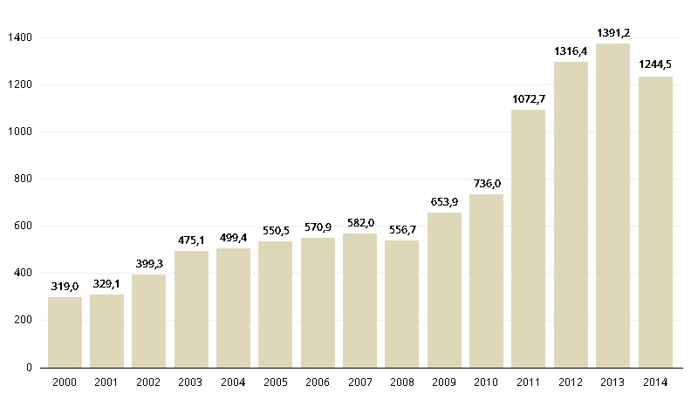
Economic and social problems arising from the accession of Portugal to the EU
DISADVANTAGES
Some numbers to understand the current situation in Portugal:
• 500.000 job losses between 2009 and 2013
• More than one million unemployed people in a country of just over 10 million inhabitants
• 35 percent of youth unemployment
NÚMERO DE DESEMPREGADOS

Slide 9
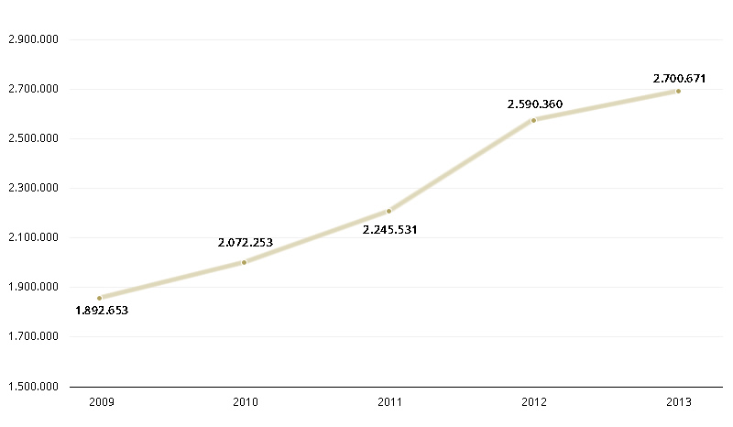
Economic and social problems arising from the accession of Portugal to the EU
DISADVANTAGES
Some numbers to understand the current situation in Portugal:
POPULAÇÃO ABAIXO DO LIMIAR DE POBREZA
Population living below the poverty line

Slide 10
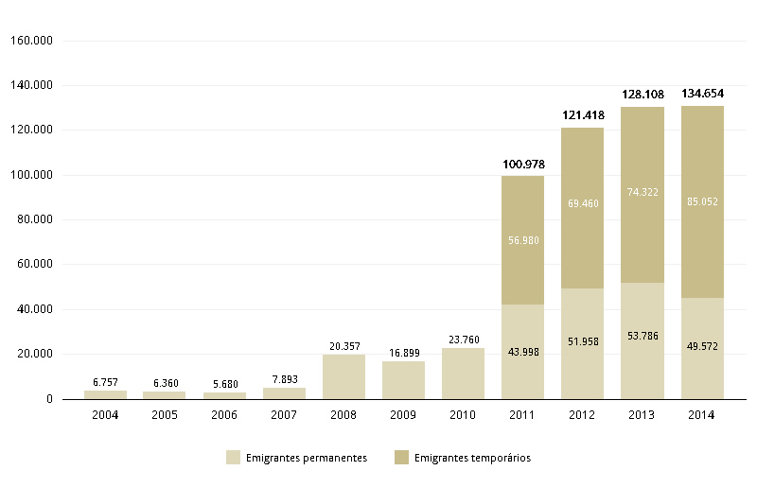
Economic and social problems arising from the accession of Portugal to the EU
DISADVANTAGES
Some numbers to understand the current situation in Portugal:
• More than 500.000 emigrants (the number of 23.000 Portuguese who emigrated in 2009 went up to 134.000 in 2014)
EMIGRAÇÃO EM PORTUGAL ENTRE 2002 E 2014

Slide 11
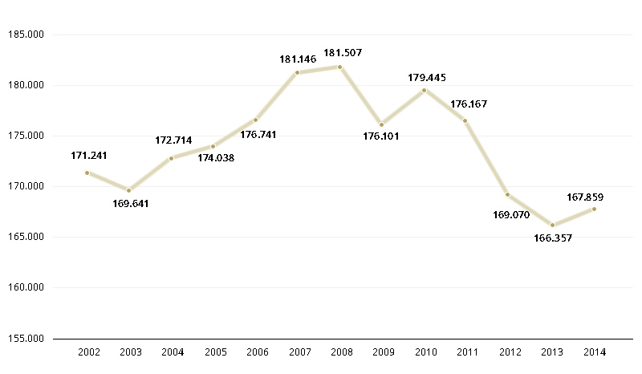
Economic and social problems arising from the accession of Portugal to the EU
DISADVANTAGES
Some numbers to understand the current situation in Portugal:
• Real Gross Domestic Product fell from EUR 182 billion in 2008 to EUR 168 billion in 2014
EVOLUÇÃO REAL DO PIB

Slide 12
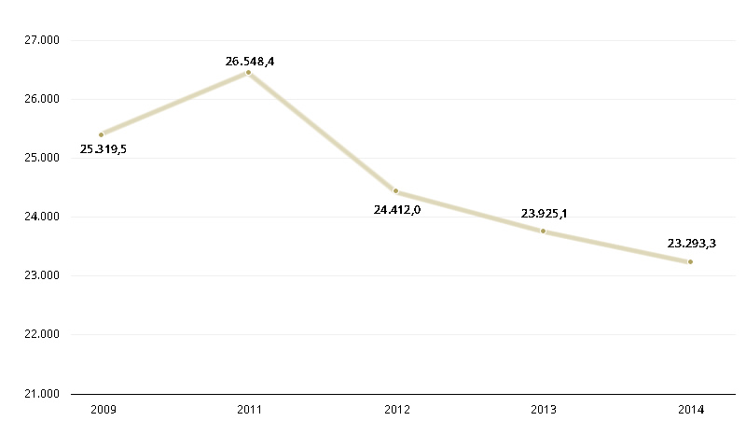
Economic and social problems arising from the accession of Portugal to the EU
DISADVANTAGES
Some numbers to understand the current situation in Portugal:
• Public investment declined from 7.2 billion in 2009 to EUR 3.5 billion in 2014
DESPESAS COM EDUCAÇÃO, SERVIÇO NACIONAL DE SAÚDE
E PRESTAÇÕES SOCIAIS

Slide 13
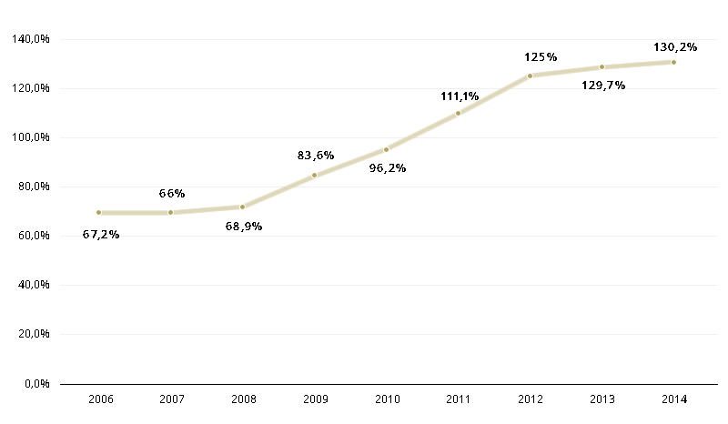
Economic and social problems arising from the accession of Portugal to the EU
DISADVANTAGES
Some numbers to understand the current situation in Portugal:
• Gross external debt stands at 235% of GDP
• Public debt stood at 130,2% of the GDP in 2014
EVOLUÇÃO DA DÍVIDA PÚBLICA EM % DO PIB

Slide 14

These examples clearly show us the fragility of the pillars of the European Union.
Thus, the data provide evidence of the profound contradictions which the European Union faces today and that possibly already lie at its origins.
Against this background, the only answer will be to stop pursuing a mistaken path which, if we continue along it, will lead to the ultimate crisis of Europe.
Together we must call and work for a European response to general crises.
Hopefully, debates like this will contribute to rethink policies and strategies to overcome the social and economic problems of our membership.
Thank you very much for your attention!

