Slide 1
The impact on Italy of European Programmes

Slide 2
Total expenses 2007-2013
91,1 bil. Euro spent to date

Slide 3
Nature of the investment
Buying goods and services: 23,4 bil. Euro

Slide 4
Nature of the investment
Infrastructure:
50.9 bil. Euro

Slide 5
Nature of the investment
Business incentives:
11,2 bil. Euro

Slide 6
Nature of the investment
Contributions to persons: 3,9 bil. Euro

Slide 7
Nature of the investment
Capital contributions :
1,6 bil. Euro

Slide 8
Nature of the investment
Other:
0,1 bil. Euro

Slide 9
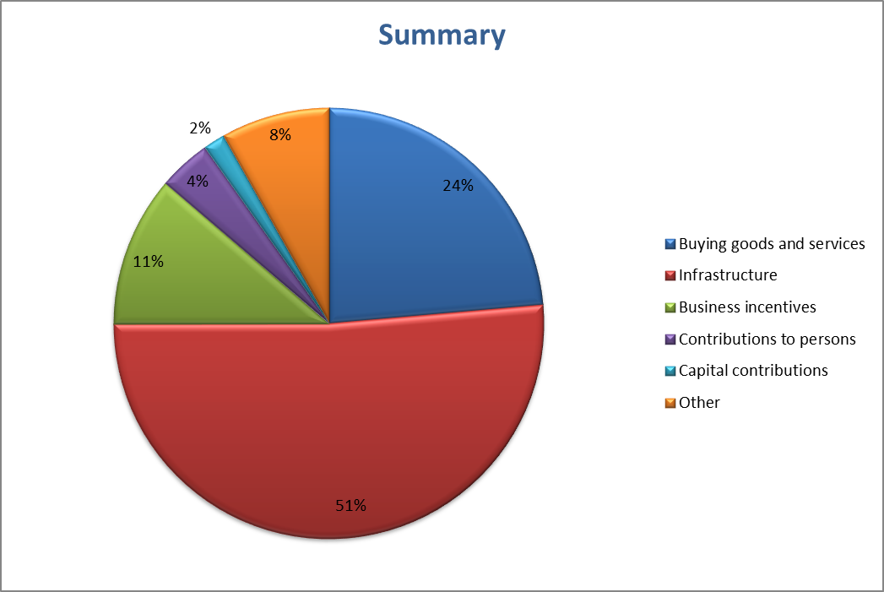
Data by Opencoesione.it

Slide 10
Sectors
Risearch and innvotion:
12,6 bil. Euro

Slide 11
Sectors
Digital agenda:
2,9 bil. Euro

Slide 12
Sectors
Enterprises competitiveness:
3,2 bil. Euro

Slide 13
Sectors
Energy:
2,7 bil. Euro

Slide 14
Sectors
Environment:
10,5 bil. Euro

Slide 15
Sectors
Culture and tourism:
5 bil. Euro

Slide 16
Sectors
Social inclusion:
24,8 bil. Euro

Slide 17
Sectors
Employment:
8,5 bil. Euro

Slide 18
Sectors
Social inclusion:
4,9 bil. Euro

Slide 19
Sectors
Children and elderly:
0,4 bil. Euro

Slide 20
Sectors
Education:
9,1 bil. Euro

Slide 21
Sectors
Cities and rural areas:
3,7 bil. Euro

Slide 22
Sectors
Strengthening public administration:
2,8 bil. Euro

Slide 23
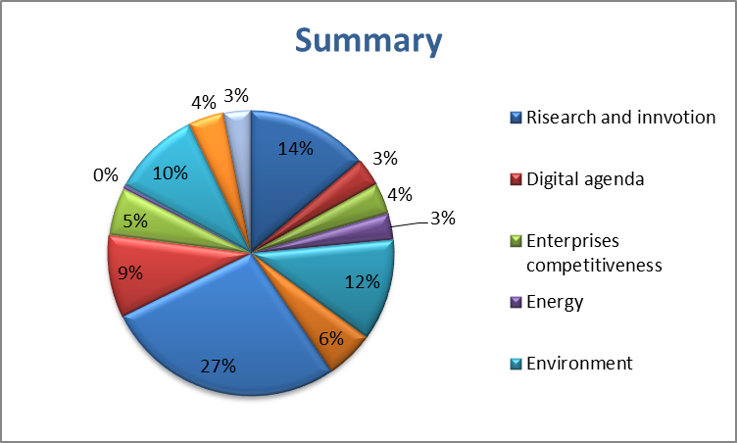
Data by Opencoesione.it

Slide 24
Thanks for your attention

