Slide 1






Europe in the Future-Multifaceted and Unified
PHOTO EXHIBITION OF TWINNED TOWNS

Slide 2
Taraclia, Moldova
2008

Slide 3
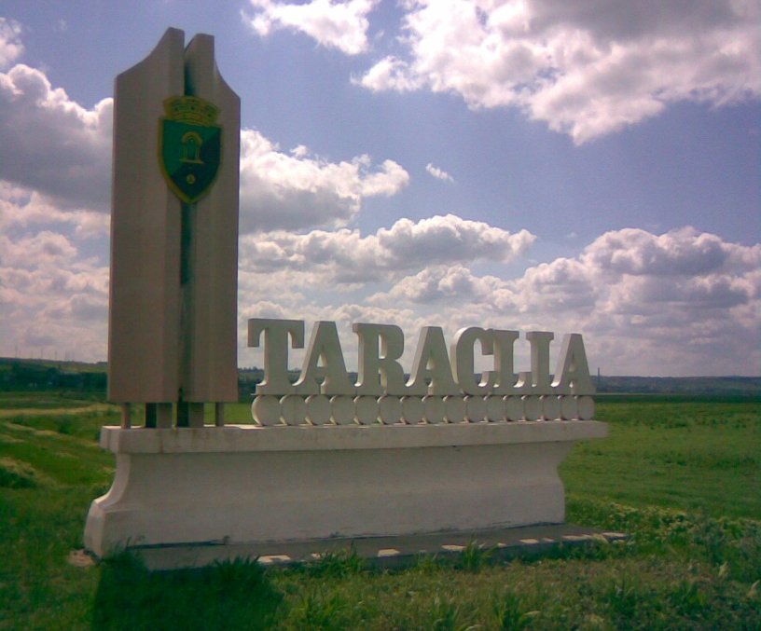
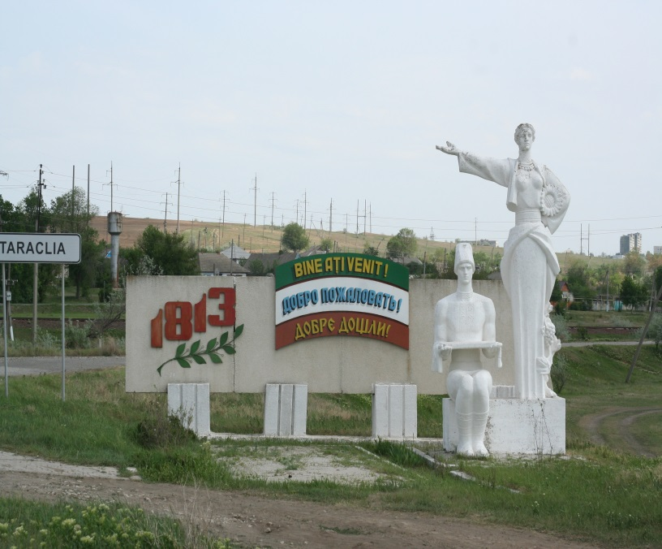
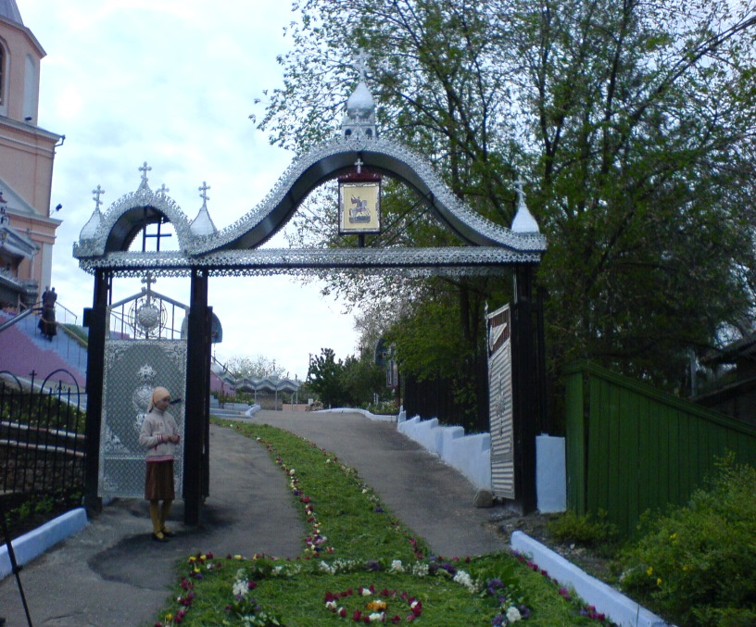
Население: 14 900 души
Population: 14 900

Slide 4
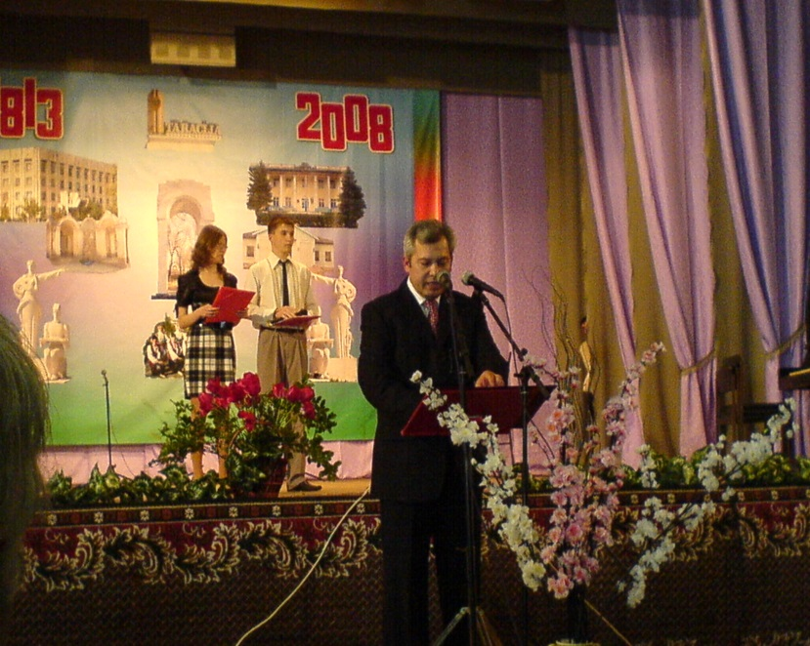
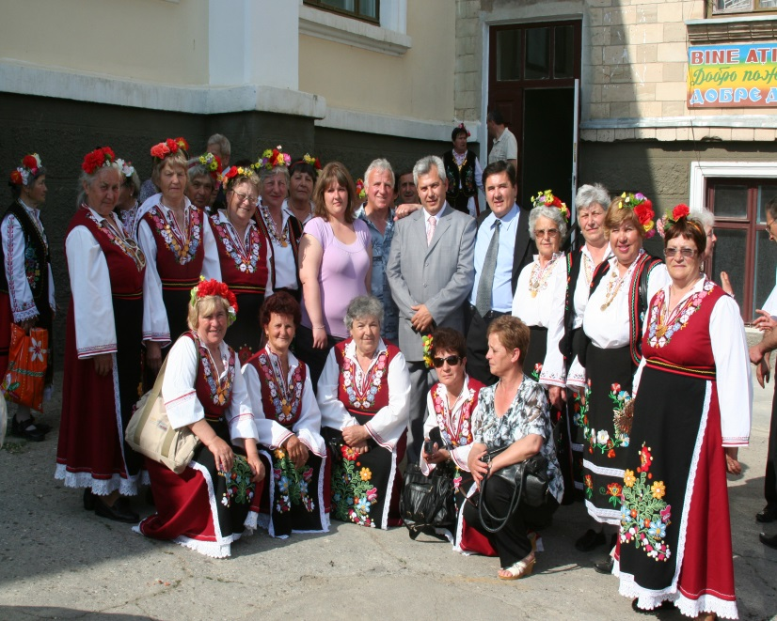

Slide 5
Igualada, Spain
2009

Slide 6
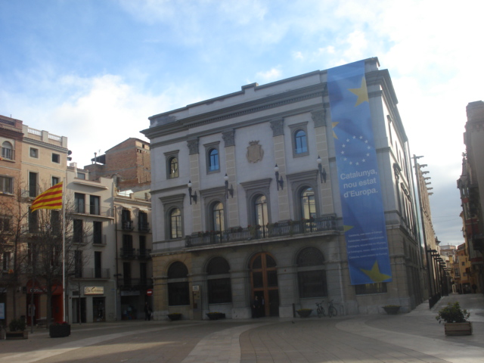
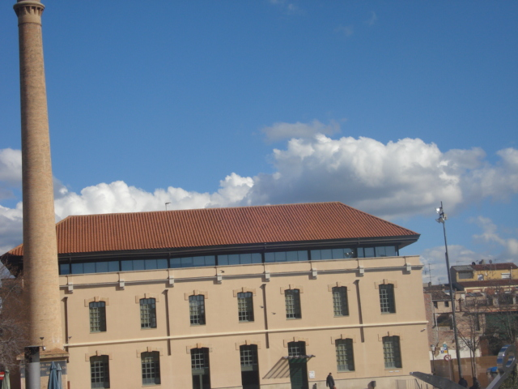
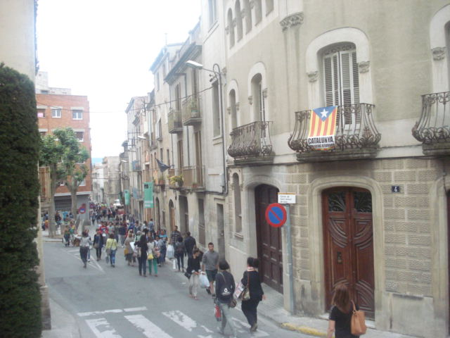
Население: 39149 жители
Population: 39149

Slide 7
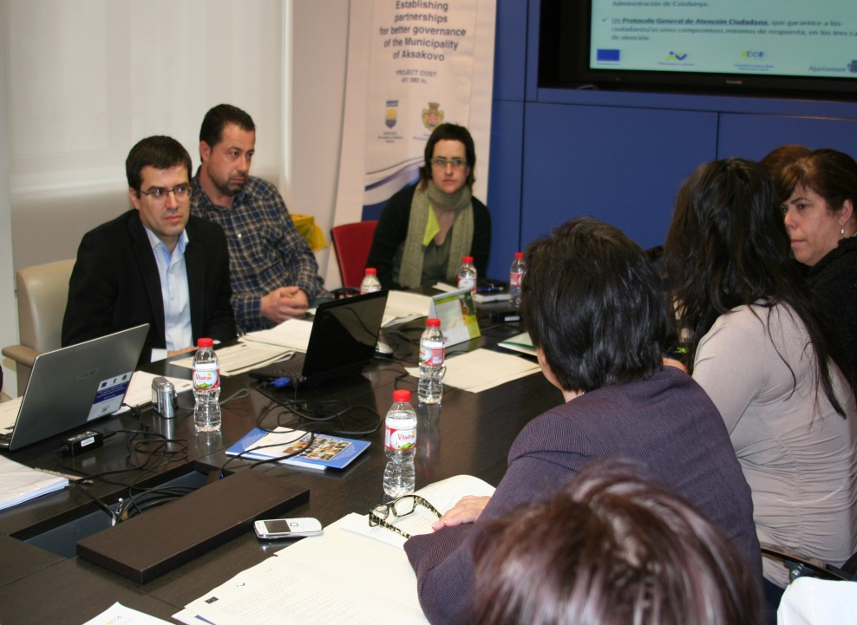
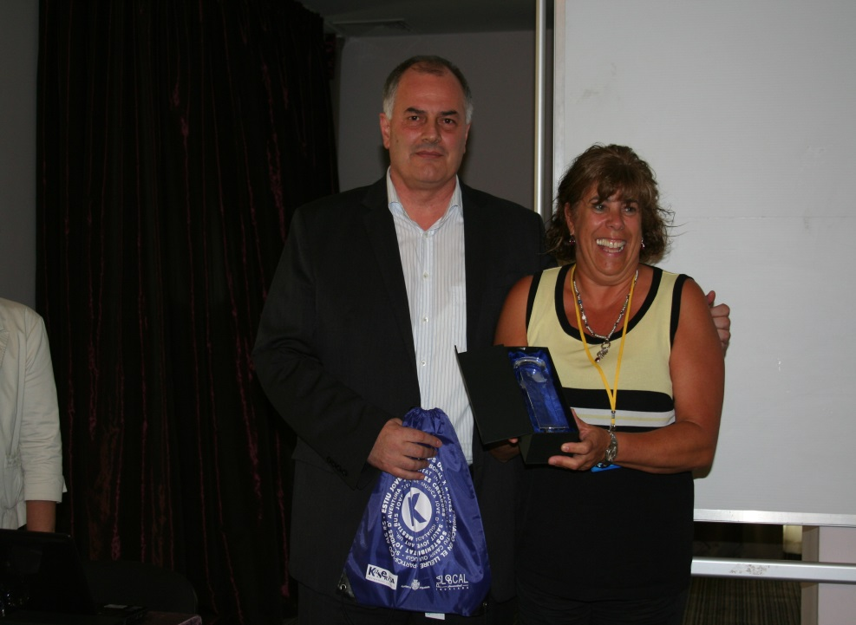
2013
Project “Building partnerships for better management of Aksakovo municipality”

Slide 8
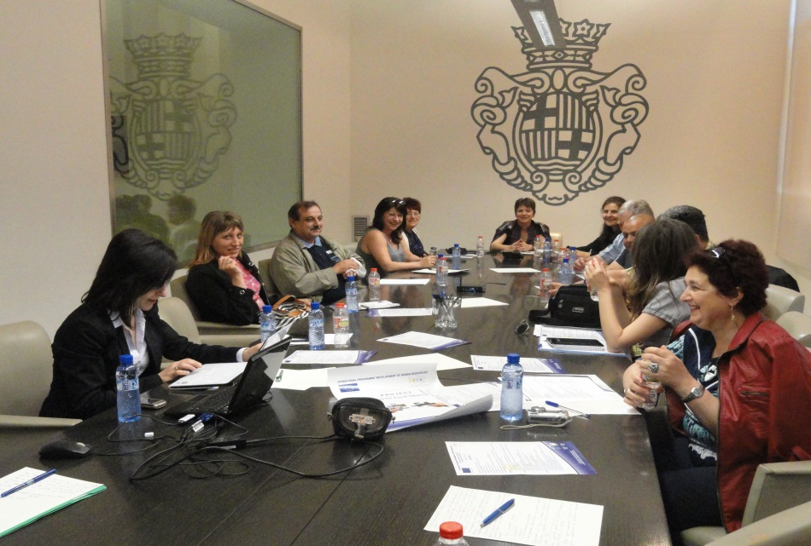
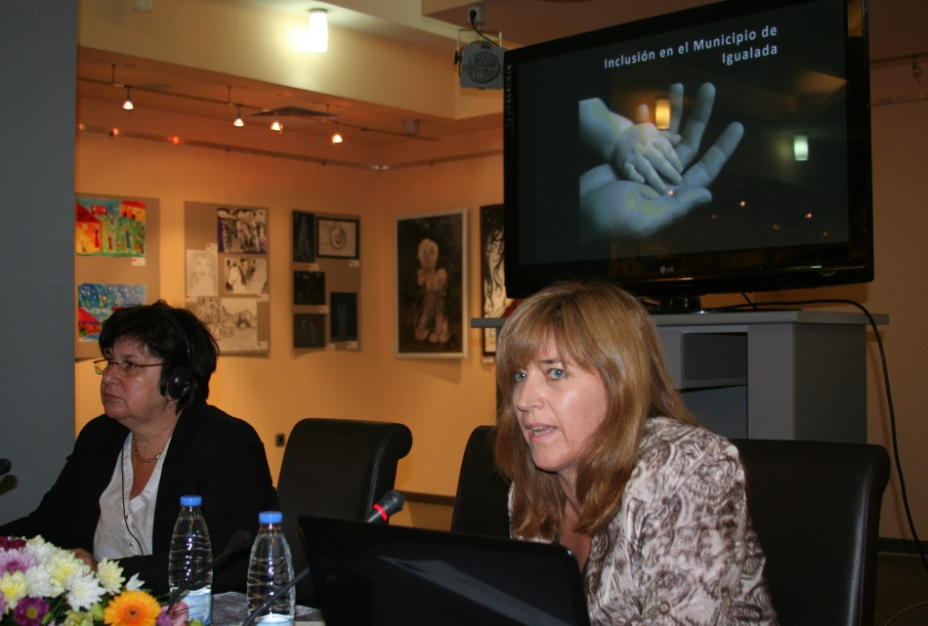
2014
Project “Partnership for equal opportunities”

Slide 9
Cherasko, Italy
2010

Slide 10
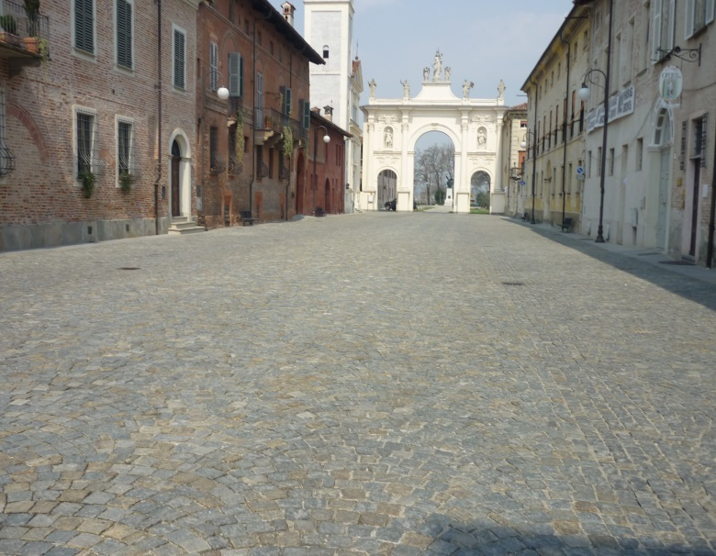
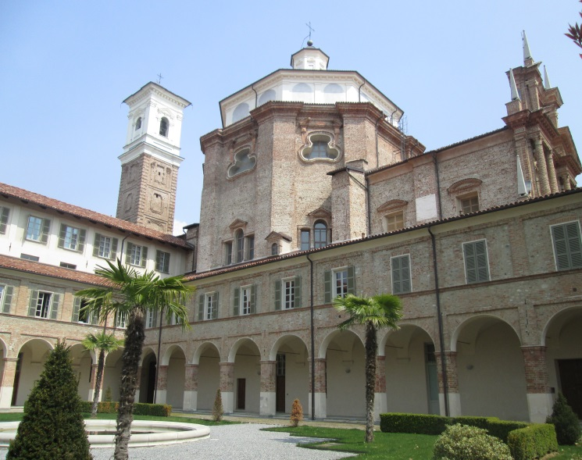
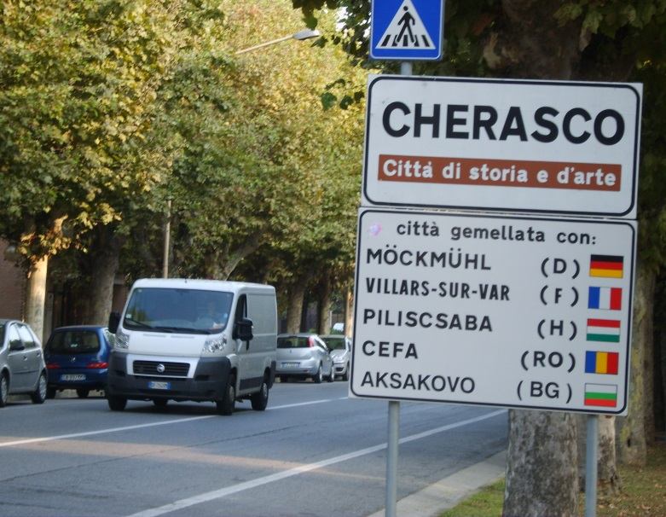
Население: 7928 жители
Population: 7928

Slide 11
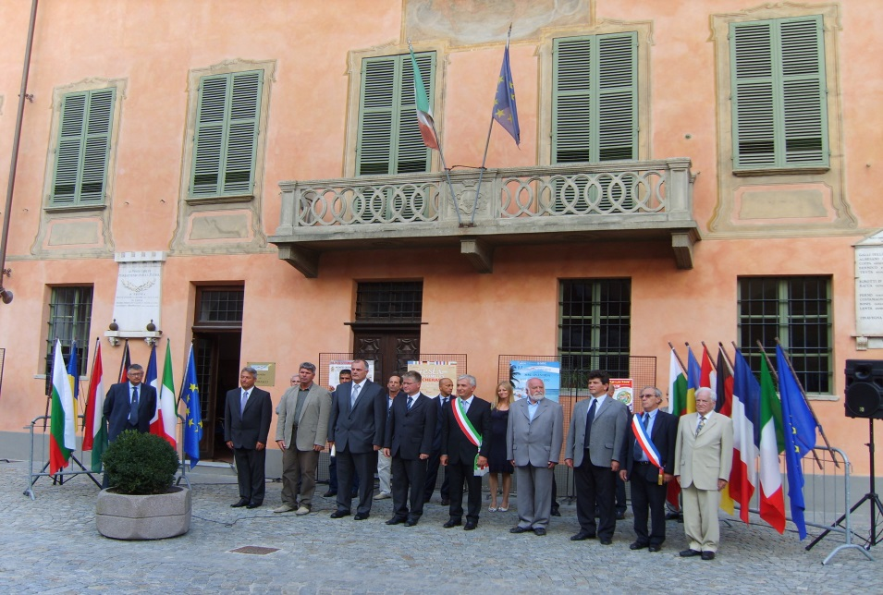
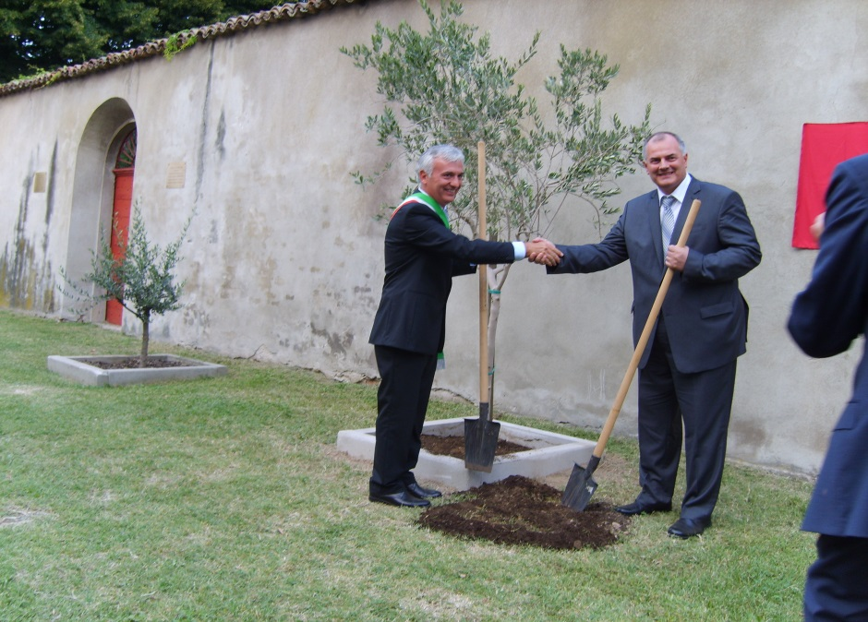

Slide 12
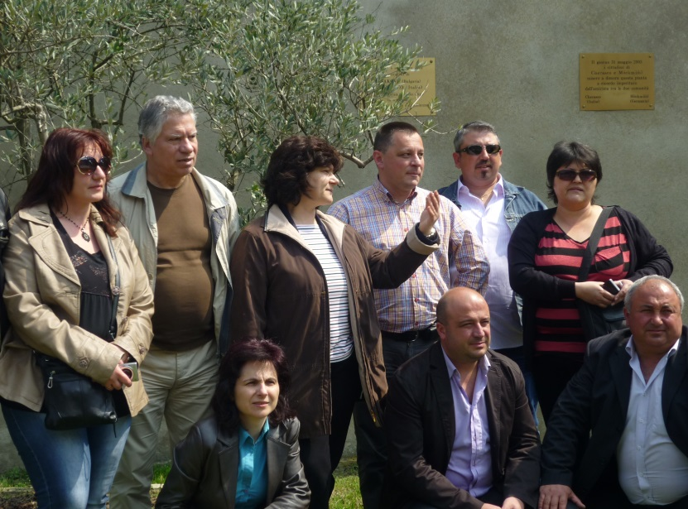
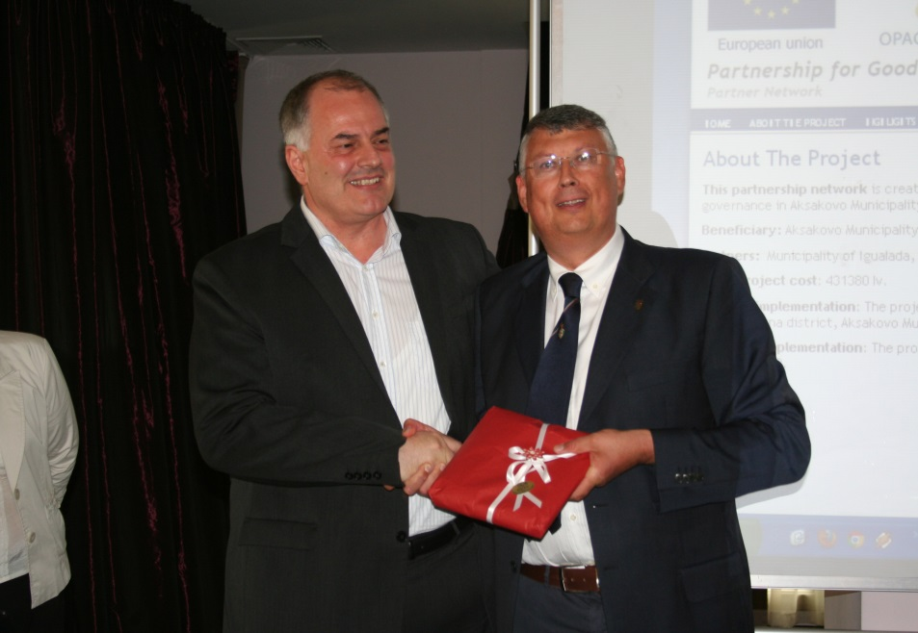
2013
Project “Building partnerships for better management of Aksakovo municipality”

Slide 13
Setubal, Portugal
2012

Slide 14
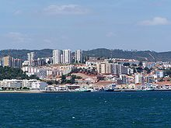
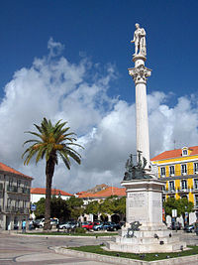
Население: 135 125 жители

Slide 15
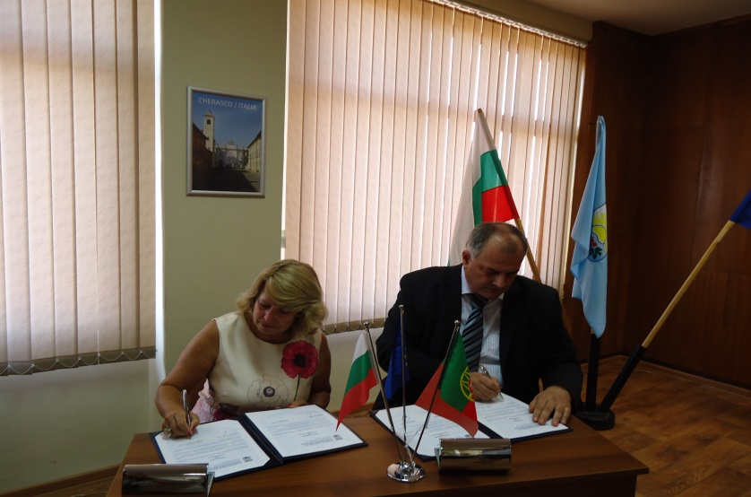
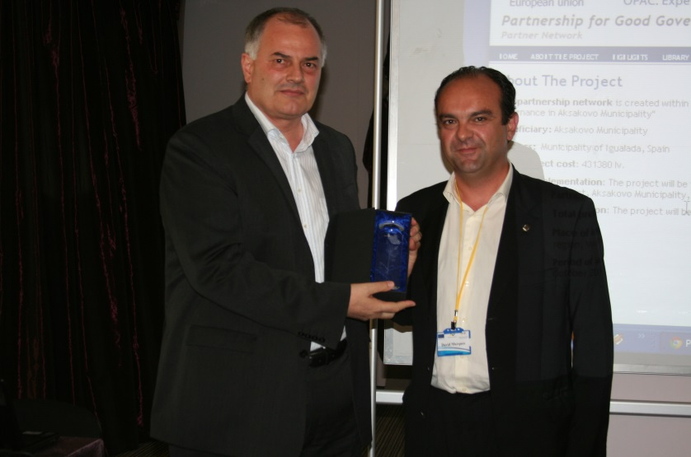
2013
Project “Building partnerships for better management of Aksakovo municipality”
2012
Signed cooperation agreement

Slide 16
Möckmühl, Germany
2013

Slide 17
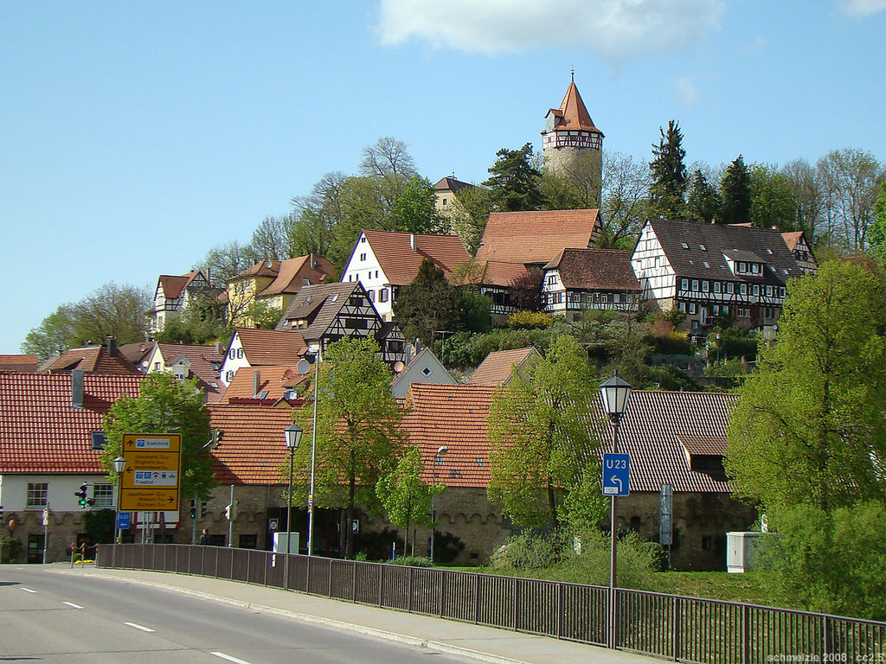
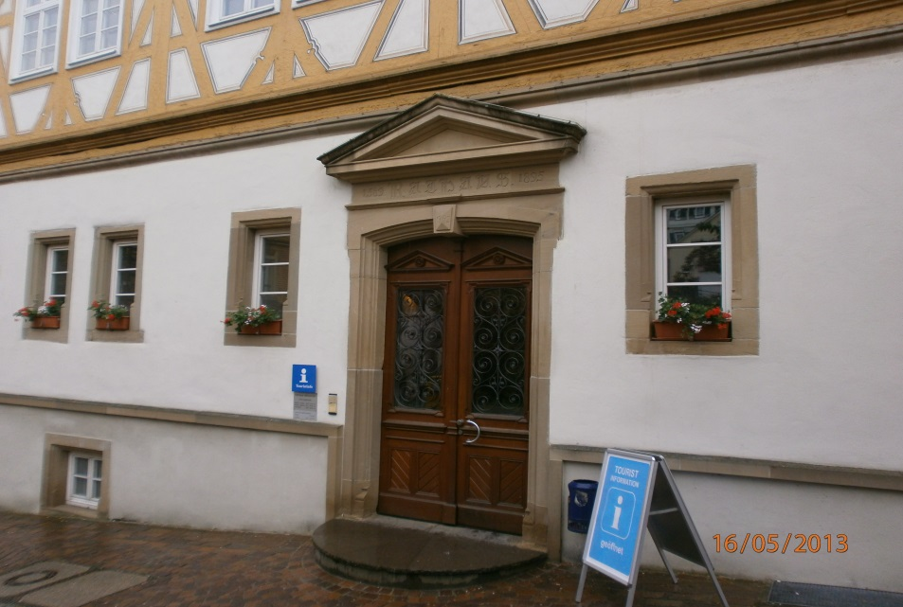
Население: 7819 жители
Population:7819

Slide 18
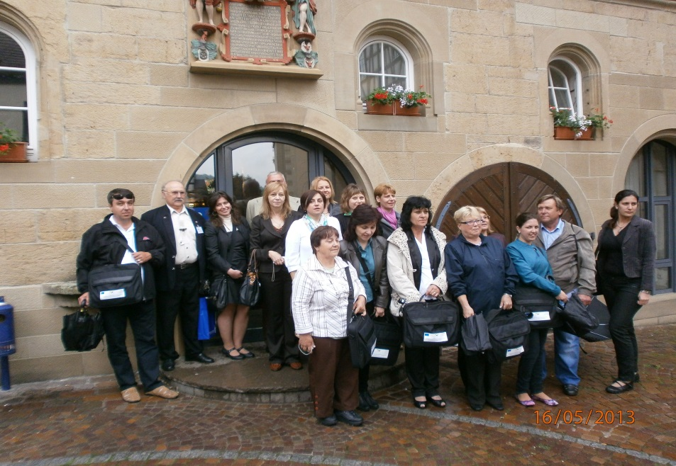
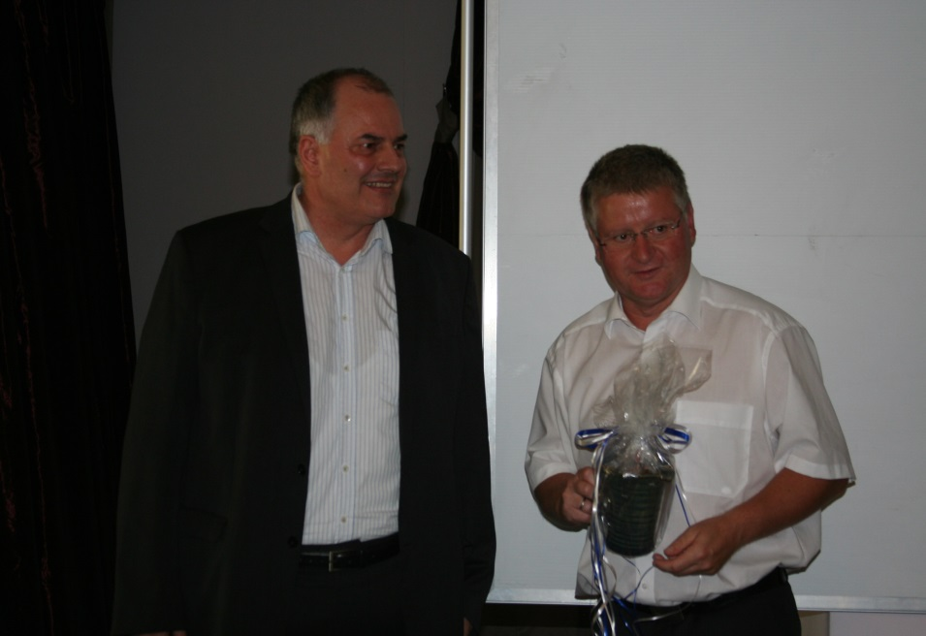
2013
Project “Building partnerships for better management of Aksakovo municipality”

Slide 19
Cernavodă, Romania
2014

Slide 20
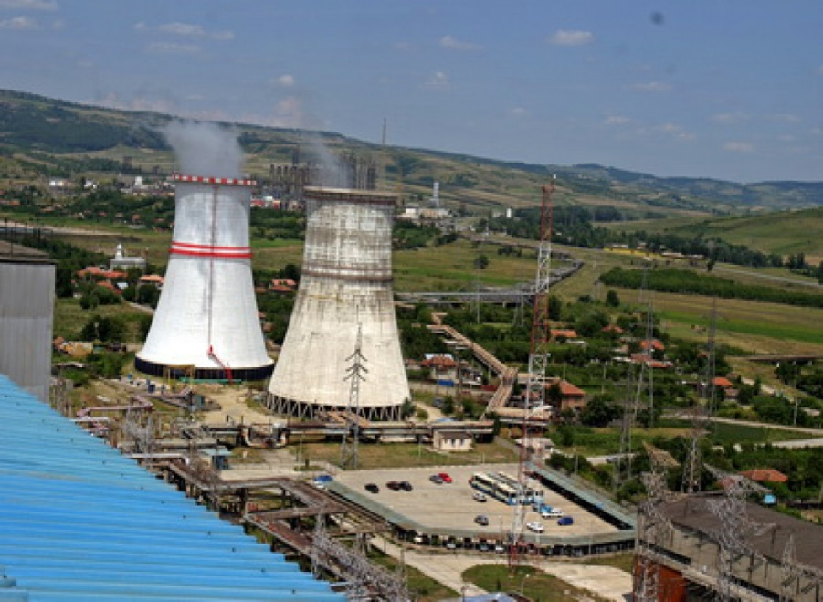
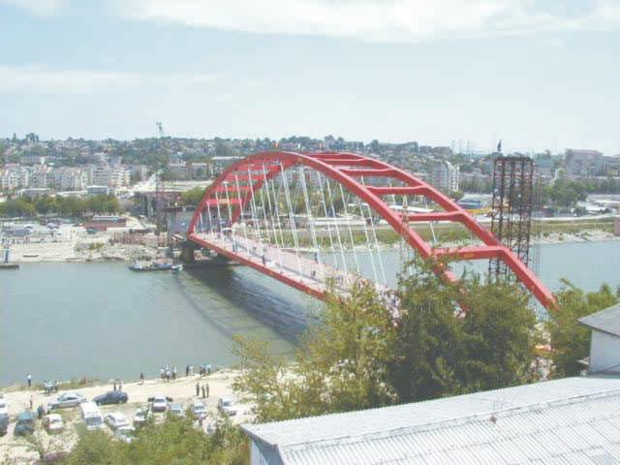
Население: 16129 жители
Population: 16129

Slide 21
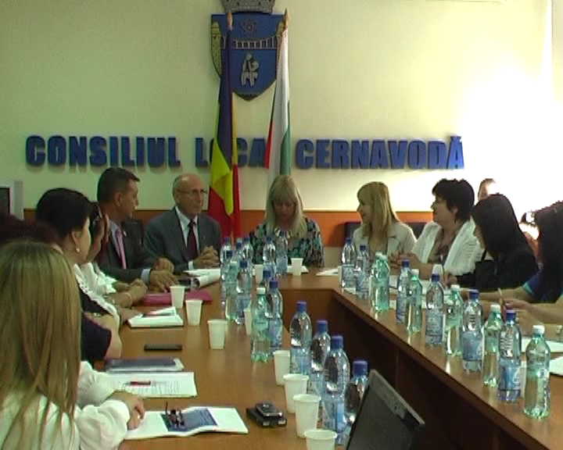
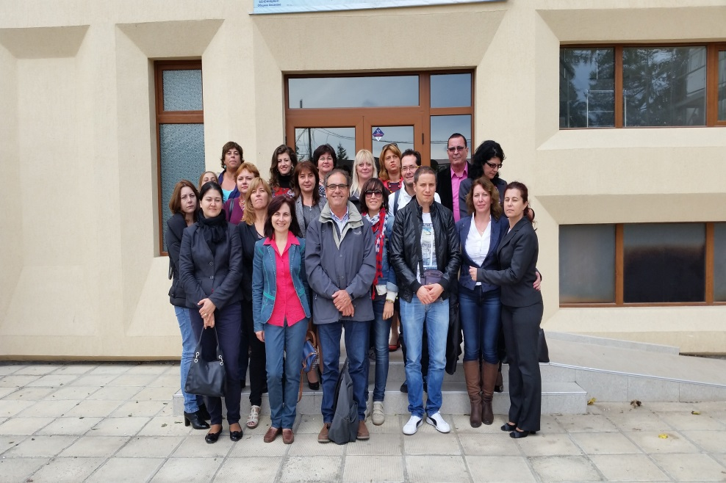
2014
Project “Partnership for equal opportunities”

Slide 22
Powiat warszawski zachodni, Poland
2015

Slide 23
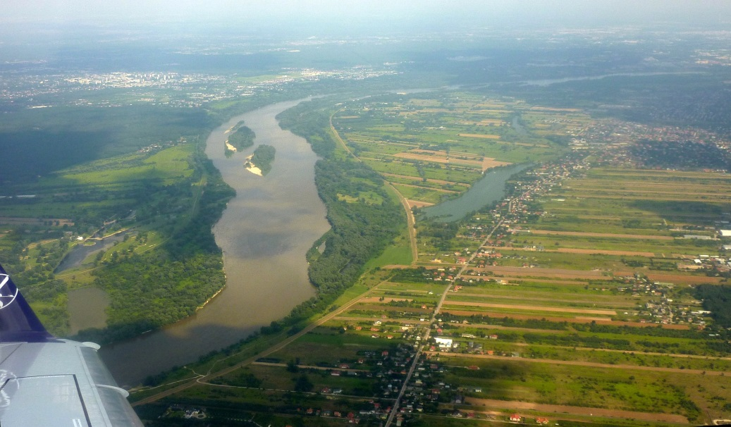
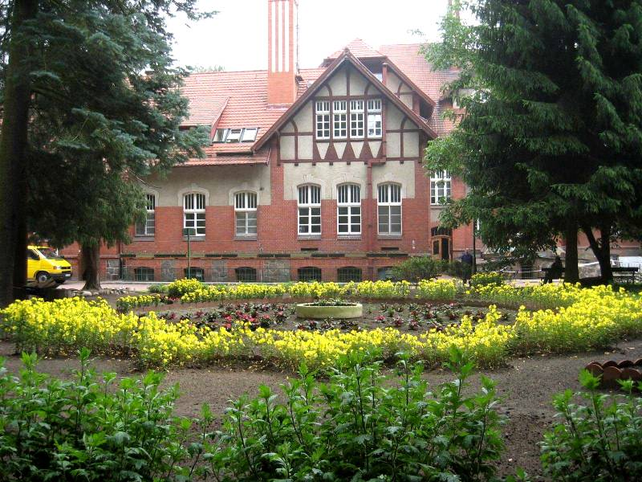
Население: 108264 жители
Population: 108264

Slide 24
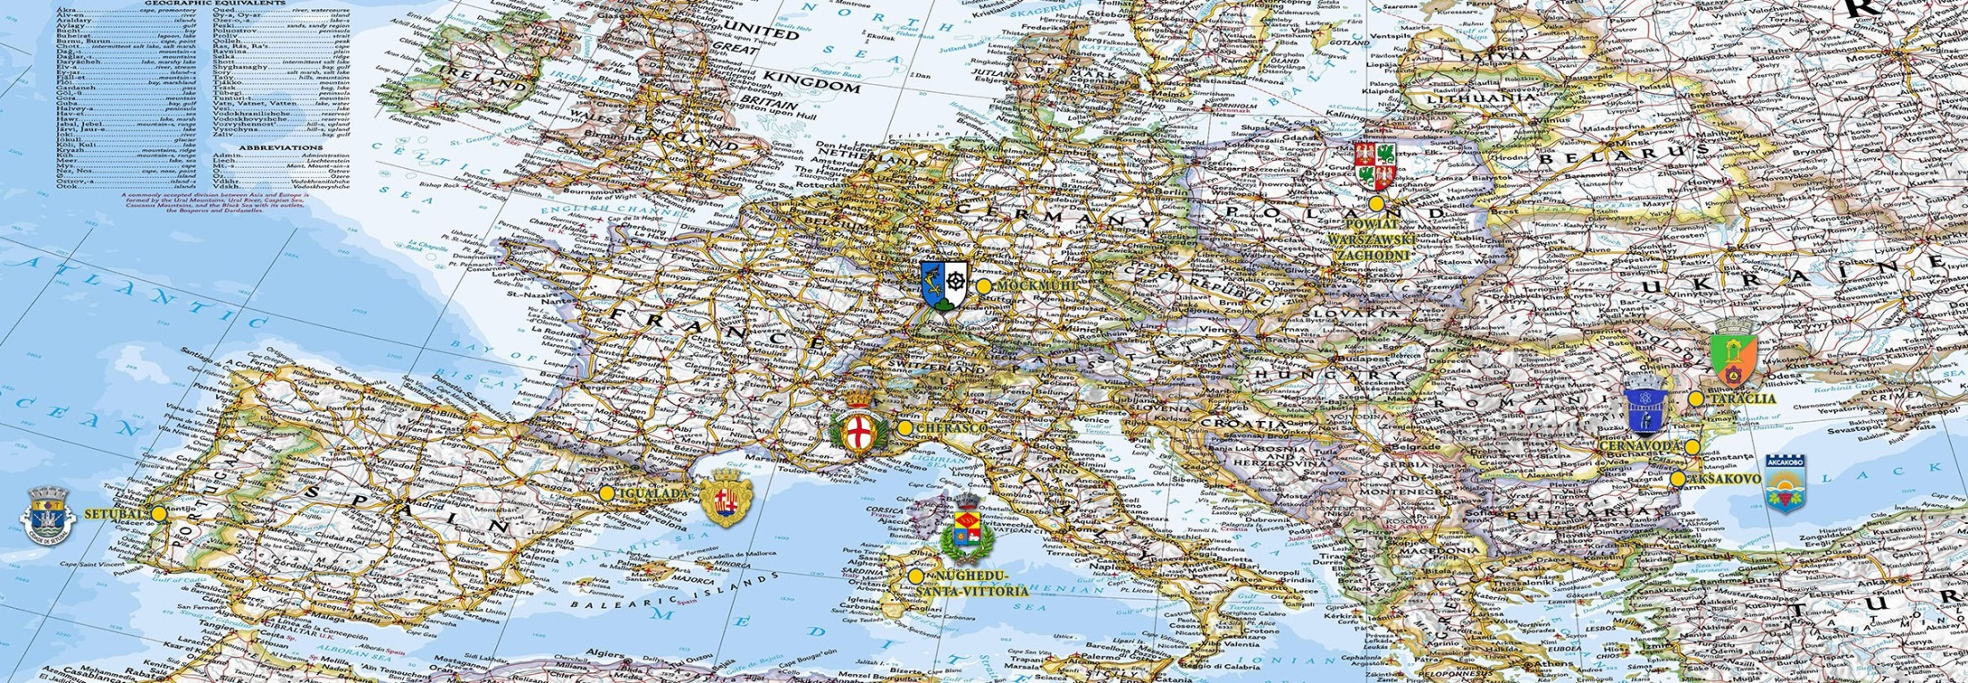

Slide 25
Thanks for attention!

